Slide 1
Computers in the Geosciences
Introduction to Data Analysis
Wolfgang Kiessling

Slide 2

Data in the geosciences
Geologists and paleontologists depend on observations with a great degree of uncertainty
Statistics important to get a hand on the degree of uncertainty and to separate noise from signal
Usually a hypothesis is tested but data analysis can also be exploratory
Data are diverse and increasingly large: Big Data

Slide 3
Typical questions
  Sample X is dominated by non-microbial micrite, followed by bioclasts and microbialite
    What are the values and their errors?
  Olivine is more common in sample X than in sample Y
  Fossils before an event are larger than after the event
    By how much and does this mean anything?
  There are different fossil assemblages in each facies
    What means different? Are there some communities less distinct than others?
  Climate change governs the fate of reefal ecosystems
    Now this is tricky. Hypothesis needs to be dissected into testable hypotheses

Slide 4
Hypothesis Testing with Statistics
You can never proof, only disproof a statistical (scientific) hypothesis
Null-hypothesis
  Randomness prevails, no significant pattern
  Example: Corals in outcrop A are as common as in outcrop B
Alternative Hypothesis
  Distinct pattern, must be clearly specified
  Example: Corals in outcrop A are more common than in outcrop B (one-sided test), OR coral abundance is significantly different between outcrops A and B (two-sided test)
Multiple alternative hypotheses are often possible
  If two or more hypothesis have the same explanatory power for an observation, we accept the simpler one until we can reject it (Ockham‘s Razor)
Notes:
Same in science according to Popper.

Slide 5
Statistics for Hypothesis Testing
Aim: Reject a null hypothesis with reasonable confidence (reasonable usually means 95% confidence)
  p-values are important: Probability that the null hypothesis is true (thus the smaller the better)
  Convention
    p ≤ 0.1 (marginally significant, rarely used)
    p ≤ 0.05 (significant, the current gold standard)
    p ≤ 0.01 (highly significant, soon to be established as standard)
  Increasingly, p-values are replaced with confidence intervals
Errors of statistical tests
  Type I error: The incorrect rejection of a true null hypothesis. False positive. Detect an effect that is not present
  Type II error: The incorrect acceptance of a false null hypothesis. False negative. Fail to detect an existing effect

Slide 6
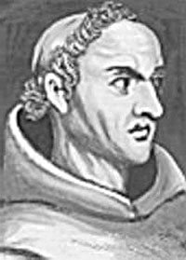

Ockham‘s Razor
William of Ockham: Franziscan Monk (1285–1349)
The Law of Parsimony
  All things being equal, the simplest solution tends to be the best one
Prefer the simplest explanation if several explanations are possible for a phenomenon
A theory is simple if it contains as few variables and hypotheses as possible, and if the individual hypotheses are logically connected and explain the phenomenon logically
In modern statistics this law is implemented by Akaike’s Information Criterion (AIC)
  Finding the balance between a model’s complexity and performance

Slide 7


Data
The raw material we collect in all our scientific life
Aim is to retrieve information and knowledge from data
  Oceans of data
  Rivers of information
  Streams of knowledge
  Drops of understanding
A.D. Chapman (GBIF)

Slide 8
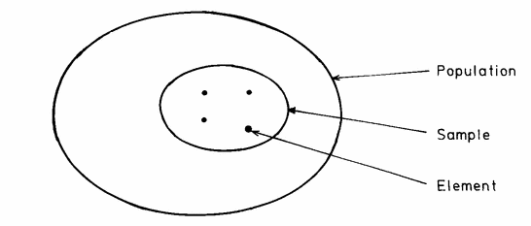
Data Basics
All items of something are the universe or population (N)
Usually impossible to collect the whole population thus we draw a sample (n) with n < N
The sample should be representative of N
  Otherwise it is biased

Slide 9
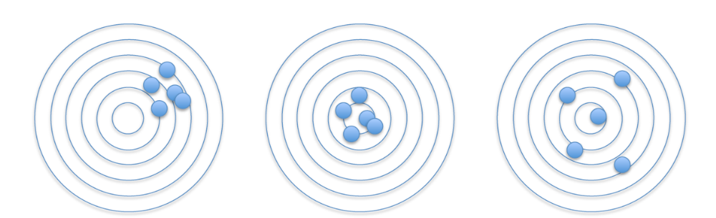
Important to distinguish between error and bias
Bias
Inaccurate
Precise and accurate
Error
Imprecise
Systematic error
Random error

Slide 10
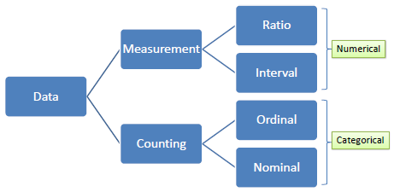
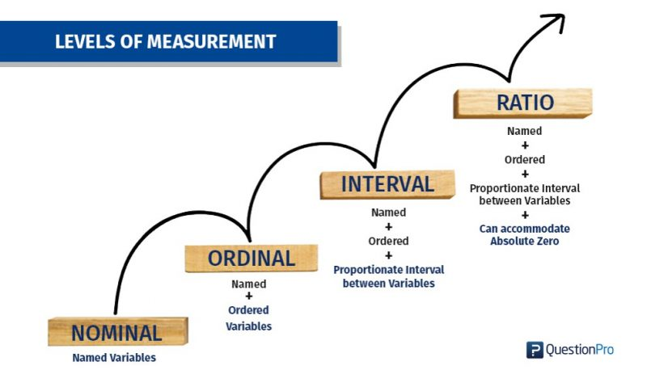
Types of Data
Qualitative (nominal)
  With or without spine, limestone or sandstone
Semi-quantitative (ordinal)
  Cold, warm, hot
Quantitative (interval)
  Degree Celsius
Quantitative (ratio)
  Degree Kelvin
Notes:
Better count ordinal data than translate into arbitrary numbers

Slide 11
Exercise
I make the claim (hypothesize) that the male students are taller than the female students
What is my null and what my alternative hypothesis?
How can you test it?
  Comparison of means (if distribution is normal)
  Comparison of medians (if it is not)
Notes:
More on distributions later

Slide 12
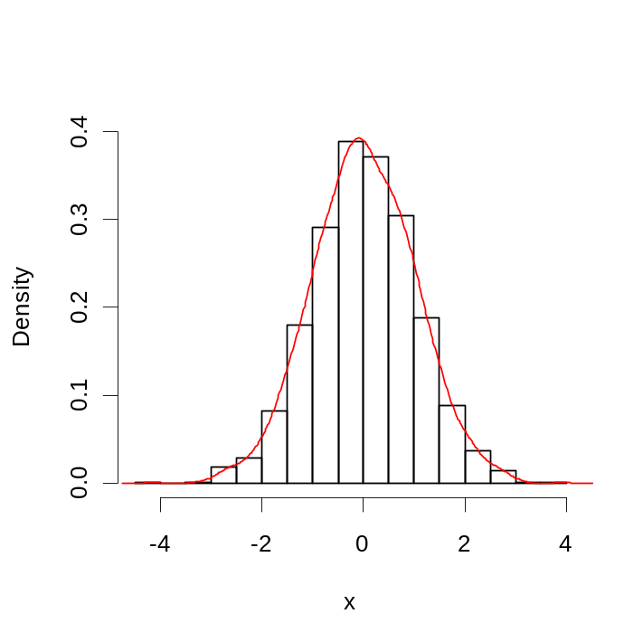
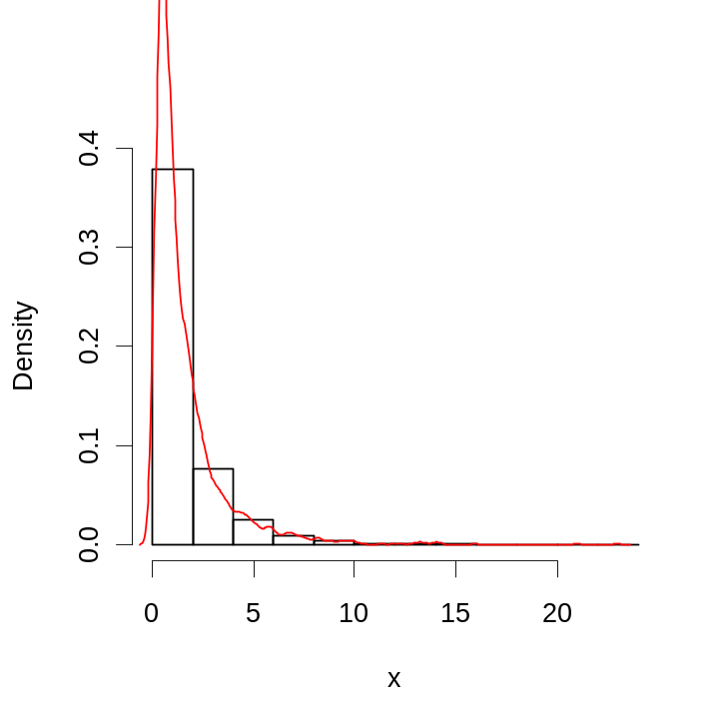
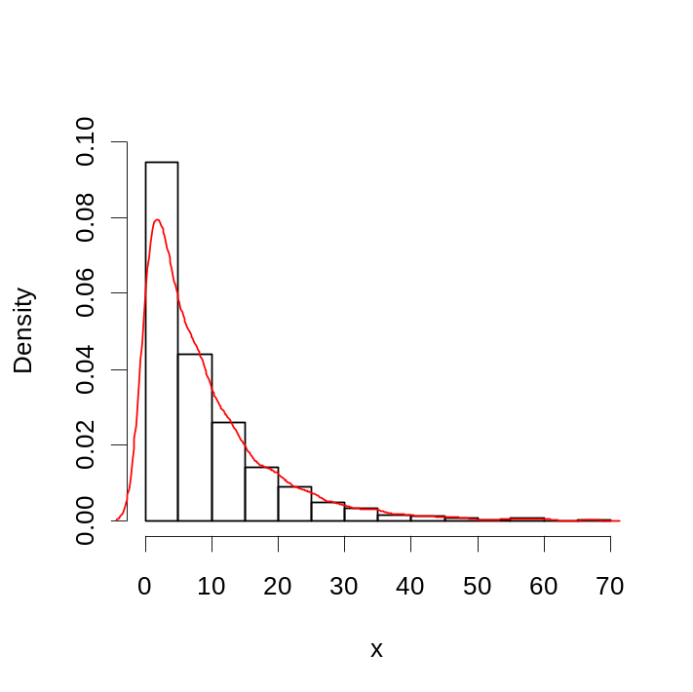
Distributions
Numerical data can have very different distributions
Parametric statistics assume normal distribution of data (Gaussian curve)
Non-parametric statistics in all other cases
Normal
Log-Normal
Geometric series

Slide 13
Why Worry About Distributions?
Distributions are important descriptors of your data
Distributions are extremely relevant for hypothesis testing
  Normal distributions: Parametric tests
    Classical statistics: actual values in focus
  Non-normal distributions: Non-parametric tests
    Statistics based on rank-orders
Parametric solutions are often preferable because
  There is a richer suite of methods
  Parametrization is often the point (e.g. what is the biotic effect of 1°C of warming?)

Slide 14
Univariate and bivariate statistics
Create a table of sizes
Add your sizes and gender to the Sizes.xlxs on Google Drive
size | gender
189 | male
… | …
… | …
… | …
https://docs.google.com/spreadsheets/d/12Pw0iMV6StA5NARO0eX3RlRQ9LourfH_/edit#gid=1630969918
Download as csv to your data folder and open the file in R
You need to rename the file to “sizes.csv”

Slide 15
Comparison of means
The Student T test
One-sample test
  Is the mean of a population different from a specified null?
Two-sample test
  Are the means of two populations different?
  Paired versus unpaired
Conduct an unpaired two-sample T test in R using the size data
Notes:
William Sealy Gosset, published anonymously as Student

Slide 16
Syntax
library(readxl)
size <- read_excel("Sizes.xlsx", 1)
m <- size$size[size$gender=="male"]
f <- size$size[size$gender=="female"]
Parametric
t.test(m, f)
t.test(m, f, alternative="greater")
Non-parametric
wilcox.test(m, f)
Notes:
William Sealy Gosset, published anonymously as Student

Slide 17
Issues with sample size
It is usually impossible to get significant patterns in small samples (small n)
  Problems to detect whether a pattern exists
It is easy to get significant patterns in really large samples, but what to they mean?
  Focus on effect size when samples are really large

Slide 18
Exercise
Assess the effect of sample and effect sizes on p-values
Take advantage of R’s random number generator
  s1 <- rnorm(100, 177)
  s2 <- rnorm(100, 178)
  t.test(s1, s2)
  s1 <- rnorm(10, 177)
  s2 <- rnorm(10, 178)
  t.test(s1, s2)
Write a loop to see at which sample size a significant effect can be detected
  Sample size as variable
  Container for p-values

Slide 19
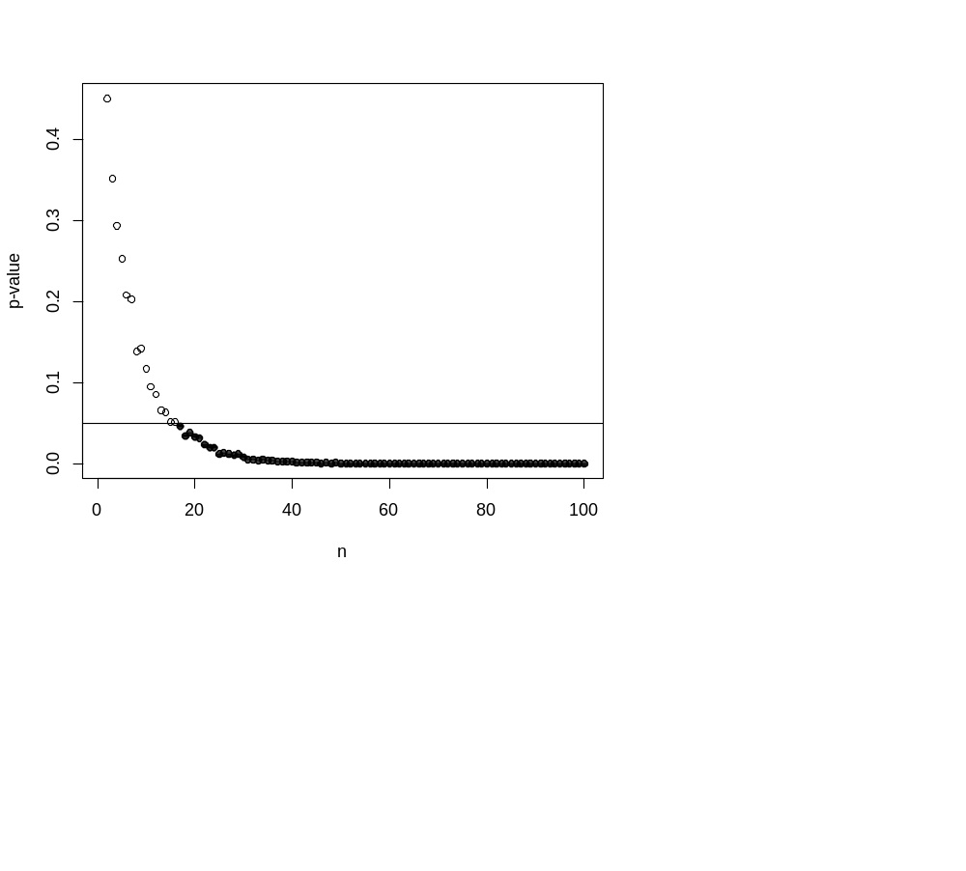
Advanced solution with nested loops (random number generator and test repeated 500 times for each sample size)
Notes:
N= 17
Effect sizes are more important than p-values. What is the effect size in this example?
Difference of 1 or ratio 178/177=

Slide 20
What to do with nominal data?
The binomial test
  How likely is it that the observed difference from equal counts is due to chance?
  Coin flip as an example
    Head or tail have same probability (p = 0.5)
    Random deviations may always occur (e.g., there is nothing to worry about if 7 in 10 flips show head – but what about 70 in 100 flips?)
    In R: binom.test(7, 10, p=0.5)
  What is the critical sample size to find a significant pattern?
Binom.test is widely used in extinction studies and environmental affinities

Slide 21
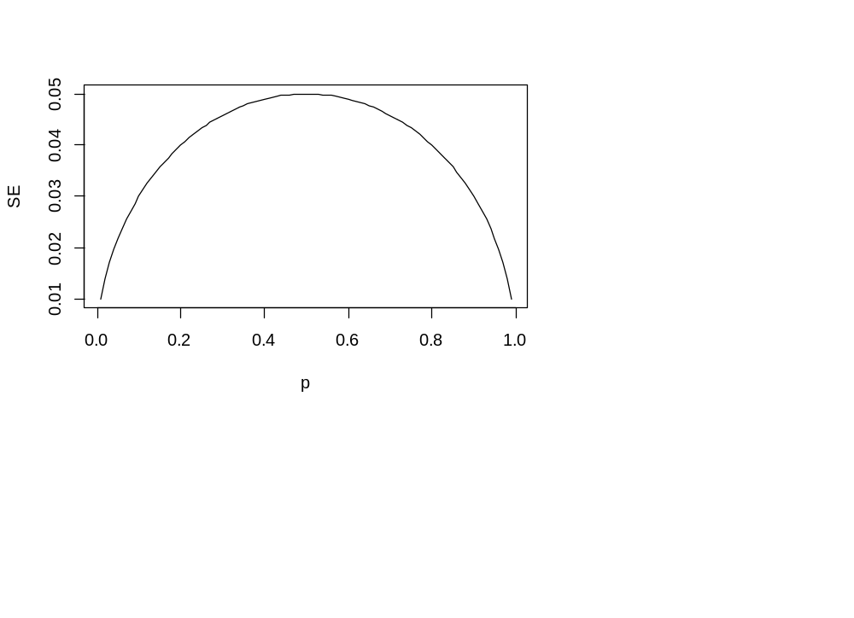
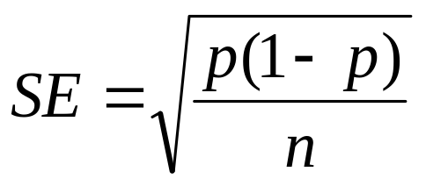
Related
The binomial error
Standard error of a proportion
  Error decreases with sample size
  Maximal at medium proportions
Write xx ± x%
  Standard errors must not overlap to show a significant difference
  95% confidence intervals 1.96 x SE

Slide 22
Comparing relative abundances
Example: Point count of two thin sections retrieves these data:
Sample 1
Sample 2
Matrix | 297
Serpulid | 214
Bryozoan | 41
Bivalve | 6
Intraclast | 121
Cement | 131
Ooid | 95
Coated grain | 5
Calcareous algae | 69
Cyanobacteria | 13
Bryozoans | 28
Peloids | 4
Serpulids | 48
Gastropods | 25
Bivalves | 7
Ostracods | 6
Foraminifers | 2
Among bioclasts, in which sample are bryozoans more abundant?
Use binomial errors to decide
Notes:
If there is time (before lunch)

Slide 23
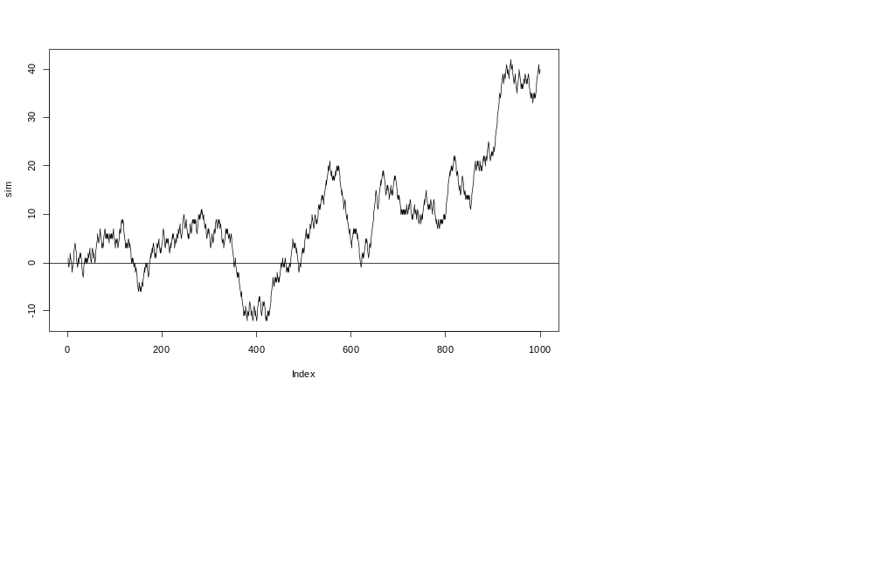
Beware of random patterns
Randomness can generate meaningful patterns
Simulate to find out

