Slide 1

Biodiversity in deep time
Wolfgang Kiessling
Paleobiology, FAU Erlangen
19-20 August 2025
Wolfgang Kiessling
Notes:
Perhaps better „assemblage-level“ biodiversity

Slide 2
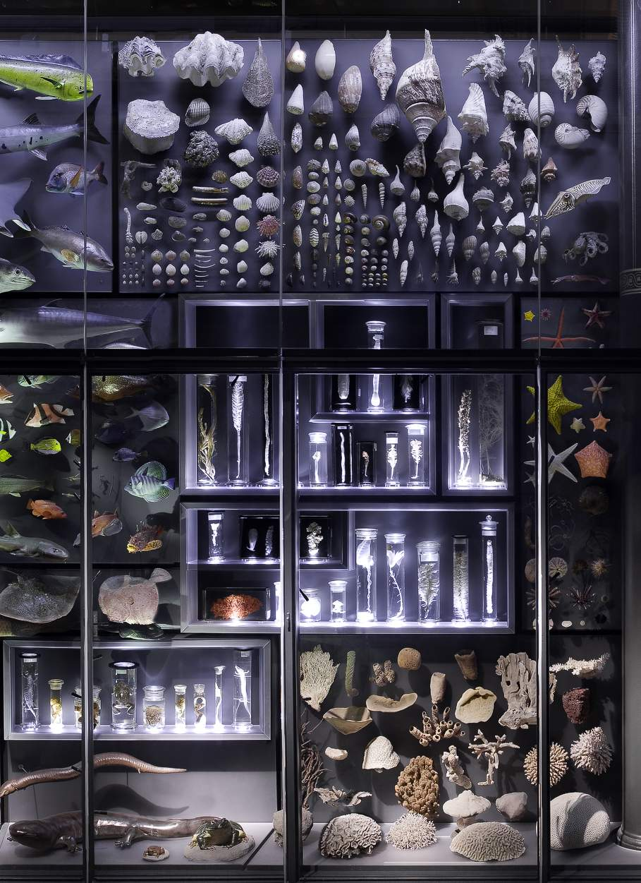
Biodiversity
The diversity of life in all its expressions on all levels of organization
Expressed by
  Genetic diversity
  Morphologic diversity
  Resource partitioning (ecological or functional diversity)
Here: ‘Number’ of taxa coexisting in a system
  Species, Genera, Families
  Problem: Define number and system!

Slide 3
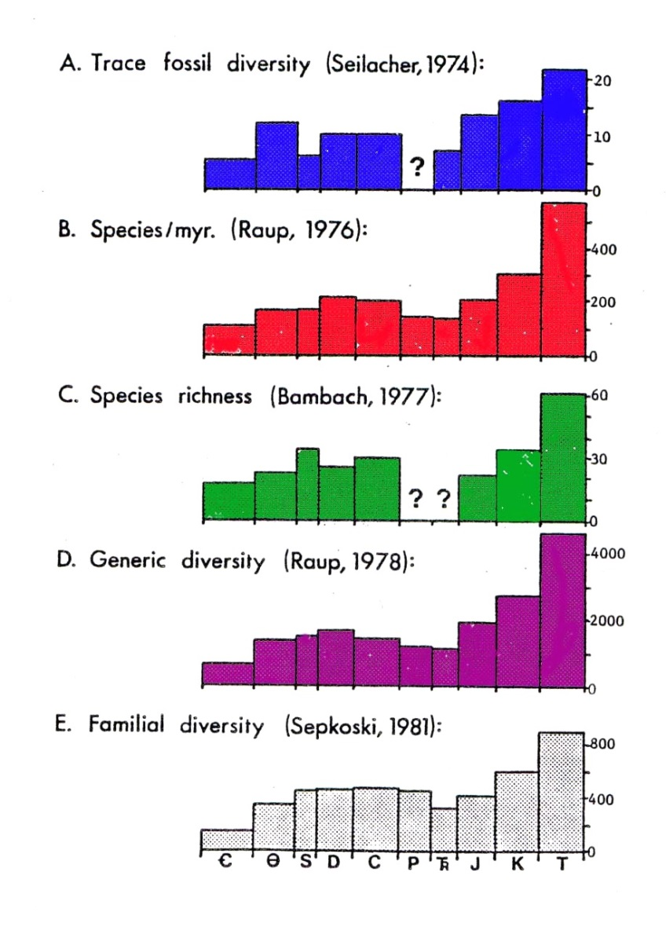
Structure
The Consensus Paper
Alpha, Beta, Gamma diversity
  Concepts and metrics
Previous analyses with Phanerozoic scope
  Alpha, beta and gammy diversity through time
Alpha diversity
  Diversity metrics and sampling standardization
  Exercise based on fossil assemblages
Beta diversity
  Measuring beta
  Exercise using fossil multivariate approaches
Sepkoski et al. (1981)

Slide 4
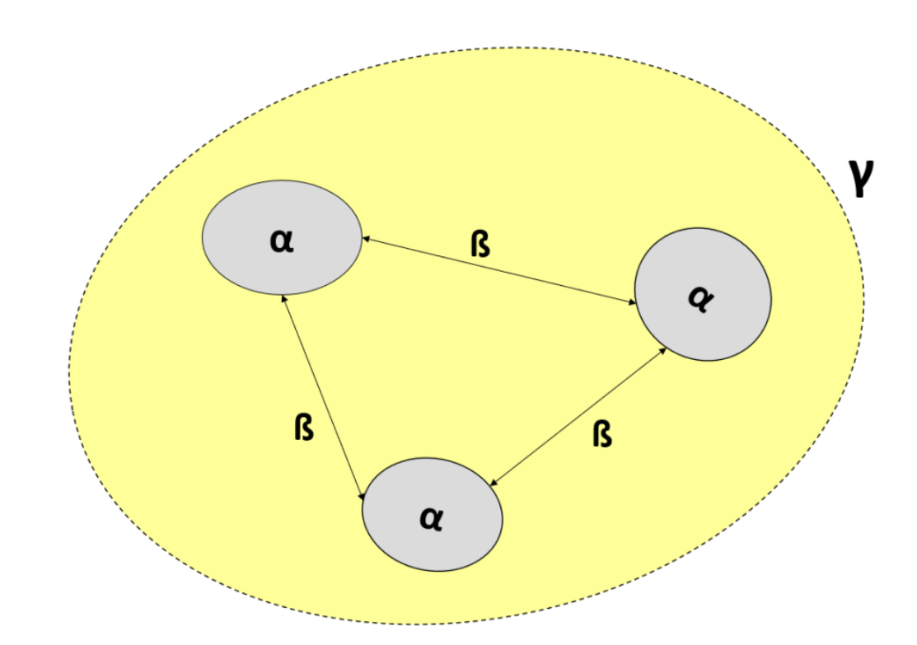
Components of biodiversity
Point diversity (Alpha) = Within community diversity
Between community diversity (Beta) = turnover
Total diversity (Gamma): Area, region, or globe
Mean(Alpha) x Beta = Gamma
Notes:
Multiplicative
Alpha can vary

Slide 5
Exercise: Alpha, Beta, Gamma
Birds in three British habitats
Species | Wood | Hedge | Open field
A | X
B | X
C | X
D | X
E | X
F | X | X
G | X | X
H | X | X
I | X | X
J | X | X
K |  | X
L |  | X | X
M |  |  | X
N |  |  | X

Slide 6
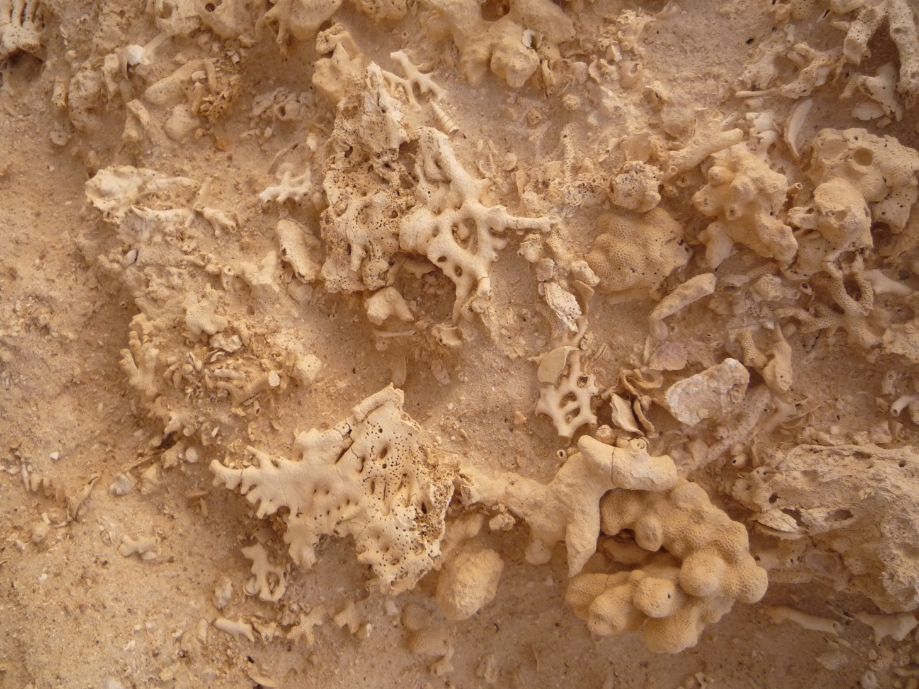
Communities, meta-communites, assemblages
Community?
Community: Interacting groups from different species living in a single habitat
Meta-communities: A set of local communities that are linked by dispersal of multiple potentially interacting species
In paleo we can only identify assemblages: a collection or group of fossils found in the same sedimentary rock layer
Notes:
But quantitative methods are the same

Slide 7
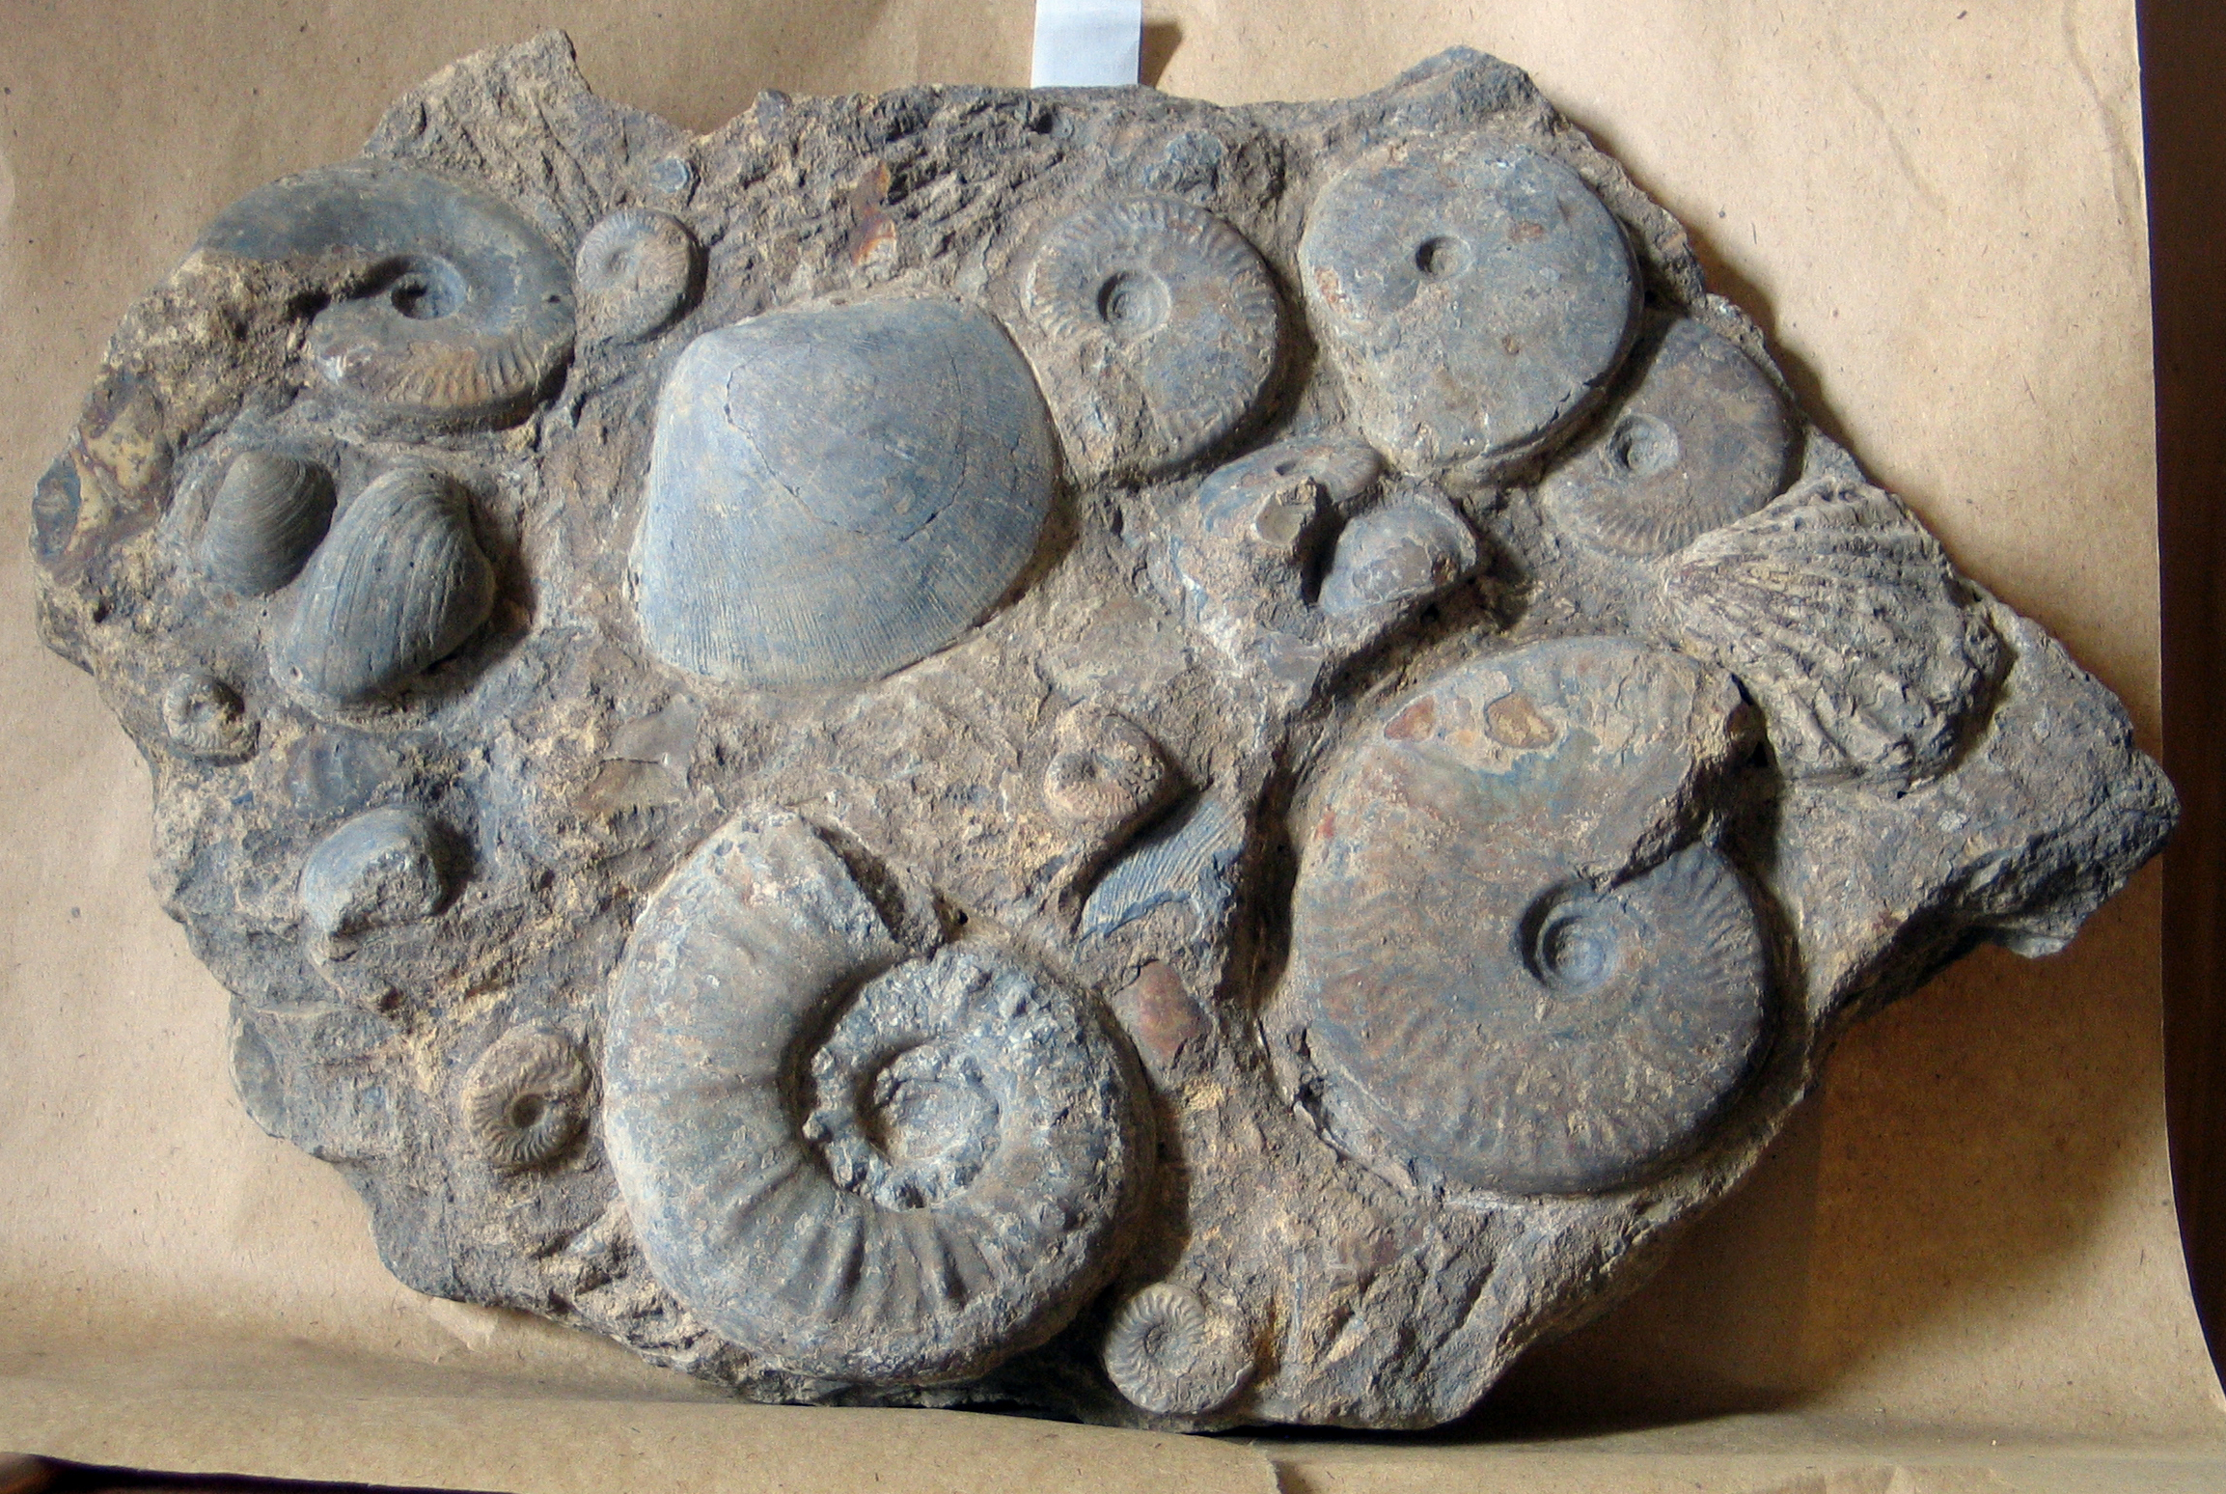
Alpha Diversity
Species richness (Number of species)
Abundance (Number of individuals per species)
Notes:
Species richness means giving maximum weight to rare species.

Slide 8
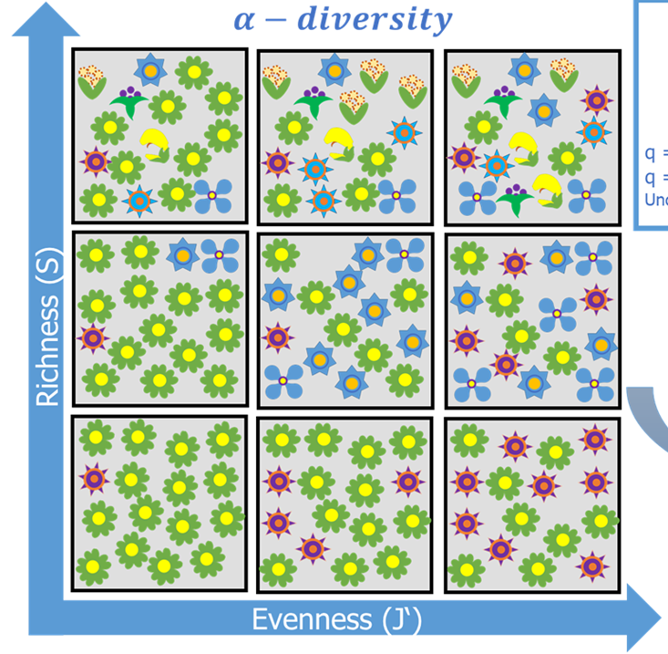
Measuring Alpha Diversity
Two essential components: richness and evenness
Simple Case
  All species are equally common
  Species numbers alone (S) provide sufficient information (but there is sampling bias)
Realistic case
  Abundance distributions are strongly skewed
  S isn‘t meaningful and sampling bias might be extreme
How to value relative abundances in diversity estimates?
  Weighing rare or common species

Slide 9
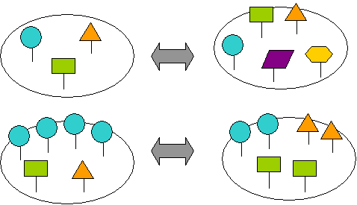
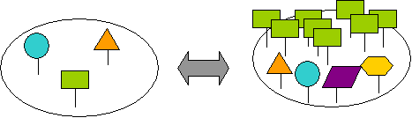
Alpha Diversity
Which community is more diverse?

Slide 10
Diversity Indices: Annotations
N = Number of Individuals
S = Number of Species
p = The proportion of a species (i) in a community
  Most commonly used
  Shannon-Wiener Information Index (H) aka Shannon Entropy
    H = -∑ p_{i} x ln(p_{i})
    p_{i} = Proportion of the i^{th} species in the community
Natural log most common, but sometimes also log₂ or log₁₀
Notes:
the cross entropy

Slide 11
Compute H for the two assemblages
H =
H =

Slide 12
Simpson’s index (dominance and diversity)
Probability that another individual belongs to the same species
  More weight on abundant species
Main term (dominance) D = ∑ n (n-1) /N (N-1)
Simplified D = ∑ (n/N) ² = ∑ p_{i}²
Simpson’s Diversity index
  SD = 1- D
Simpson’s Reciprocal Diversity Index
  RD = 1/D
Notes:
Simpson Diversity: Sometimes also 1/D
Simpson's Reciprocal Index

Slide 13
Compute D, SD, and RD for the two assemblages
D =
SD =
RD =
D =
SD =
RD =

Slide 14
Fisher’s Alpha
Fisher‘s α based on assuming a log-series distribution
P(n)= αx^{n}/n​
  Probability P that a species has n individuals
  x = shape parameter of the distribution (related to proportion of individuals in the most common species)
  α = diversity index
S = α ln(1+N/α)
  α only determined iteratively
Calculate α for S = 30 and N = 400
Notes:
1943
Many rare species (with one or a few individuals), Few common species, A “long tail” of rarities.

Slide 15
Other Indices
  Brillouin Index
    N = total number of individuals
    n = number of individuals in species x
  Margalef-Index
    D_{M} = (S-1)/ln(N)
    Good if you only know gross totals
    But only applicable to a log series distribution
  Menhinick Index
    D_{Mh} = S/√N
  Berger-Parker Dominance
    d = p_{max}

Slide 16
Most diversity indices are mixed signals of richness and evenness
Pure Evenness should only measure relative abundance distributions and be independent of richness
Evenness metrics
  Evenness J = H/H_{max}
    H_{max} = ln(S)
  Equitability E = e^{H}/S
  Hurlbert‘s PIE (Probability of Interspecific Encounter)
PIE =
Notes:
Hurlbert’s PIE is essentially Simpson’s Diversity

Slide 17
Compute J for the two assemblages
J =
J =

Slide 18
Can we get a metric that unifies H and J in a reasonable way?
The effective number of species
Aka Hill number, species diversity or true diversity
The number of equally abundant species that would produce the same diversity as the observed community
q is a parameter that determines the sensitivity to rare or common species:
q=0: Species richness (all species counted equally)
q=1: Shannon diversity (weighted by relative abundance)
q=2: Reciprocal simpson diversity (gives more weight to dominant species)
Notes:
If all species have equal abundances, the effective number of species equals the actual number of species.
If some species are much more dominant than others, the effective number of species is lower than the actual number.

Slide 19
Hill Numbers
For q = 0 (maximum weight to rare species)
  D = S
For q = 1 (equal weight to rare and common species)
  ¹D = e^{H}
For q = 2 (more weight on common species)
  ²D = 1/D = RD
For q near infinity
  The weighted generalized mean with exponent q−1 approaches the proportional abundance of the most abundant species
  1/^{Inf}D = p_{max}
Hill, M. O., 1973, Diversity and evenness: A unifying notation and its consequences: Ecology, v. 54, no. 2, p. 427-432.
Notes:
For q = 2 you get Simpson's Reciprocal Index

Slide 20
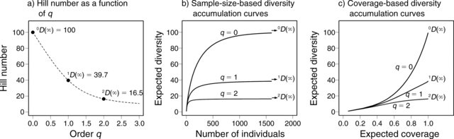
How to weigh rare species?
Critical question in diversity estimates
Rare species form the bulk of species richness but abundant species form the bulk of ecosystem services
Hill Numbers help to assess influence of to rare species on diversity

Slide 21
Use Hill numbers to generate diversity profiles
Diversity trajectories with different Hill numbers can be used to compare if true diversity is greater in one community
If diversity profiles cross, then there are no genuine diversity differences
Exercise:
Plot diversity profiles of three communities
A <- c(60, 5, 5, 5, 5, 5, 5, 5, 5, 5) # S = 10
B <- c(17, 17, 17, 16, 15, 12) # S = 6
C <- c(30, 25, 15, 10, 8, 6, 4, 2) # S = 8

Slide 22
Sampling Bias
Most indices are affected by sample size
Question: What diversity to expect if sample sizes were the same?
  Problem: Relationship between sample size and diversity is not linear
N = 12
S = 3
N = 3
S = 2
Notes:
Will hear more about this tomorrow, but methods were originally developed in community ecology

Slide 23
Rarefaction
Interpolation biodiversity
Question: Which species richness would I observe if my sample A was smaller than it is (e.g., as small as sample B)
Equation:
(read N over n) = = N!/n!(N-n)!
E(S_{n}) = expected species richness; S = number of species; N_{i} = Individuals of species i, N = Individuals in total sample, n = Subsampling quota

Slide 24
Two Approaches to Rarefaction
Mathematic solution:
  Apply the equation
Empirical solution:
  Let the computer draw specimens at random and get diversity for a given sample size

Slide 25
Shareholder Quorum subsampling (SQS) and Squares estimates
Rarefied diversity has a quota
  Quota is a fixed number of specimens for which we estimate diversity
  Diversity estimate depends on evenness
SQS has a quorum
  Quorum is a fixed coverage of the frequency (=rank-abundance) distribution
  Approximated by Good’s u: the proportion of the total number of individuals in a community that belong to species that have already been observed in your sample u=1−F1/N
  F1 = Number of single individual species
  N = total number of individuals in the sample​​

Slide 26
Biodiversity Indices and Rarefaction
Diversity indices and rarefaction of a Middle Triassic benthic community from China
We go through the script in plenary and spend time on playing with Rarefaction and Shareholder Quorum subsampling
Script: Alpha_div_new.R

Slide 27
Only for the fastest
Rarefaction with Shannon Entropy and Simpson’s Reciprocal Diversity?

Slide 28
Rank-Abundance Distributions
Patterns of relative abundances
  Major tool in Community Ecology
  More information than in common indices
  Straightforward interpretations
    Resource utilization
    Complexity of community

Slide 29
Relative Abundance of Species in Communities
Middle Triassic of China
Usual case: A few species are dominant and there are many rare species.

Slide 30
Presentation
Rank usually linear on x axis
Abundances (relative of absolute) on logarithmic scale on y axis

Slide 31
Examples
100
10
Broken Stick Model
Per Species Abundance
1
0.1
Log-Normal Series
0.01
Log Series
Geometric Series
0.001
10
20
30
40
Species Addition Sequence

Slide 32
Inferences
Evenness increases from Geometric series → Log series → Log-normal → Broken stick
Dominance decreases in same direction
Geometric: Simple community with niche pre-emption
Log-normal: Complex community with diverse guilds coexisting with their own distributions

Slide 33
What model best describes the RAD of the Triassic community?
Try package “vegan” and function “radfit”

Slide 34
Model Selection with AIC
Akaike (1974): An Information Criterion
Mostly: Akaike‘s Information Criterion
“Penalize“ models for complexity (number of parameters)
  AIC = -2*ln(likelihood) + 2*K
  Likelihood → The fit of the model
  K the number of parameters
The smaller the AIC the better
If n/K < 40 use small-sample size correction
  AICc = -2*ln(likelihood) + 2*K + (2*K*(K+1))/(n-K-1)
Or BIC (Bayesian Information criterion)

Slide 35
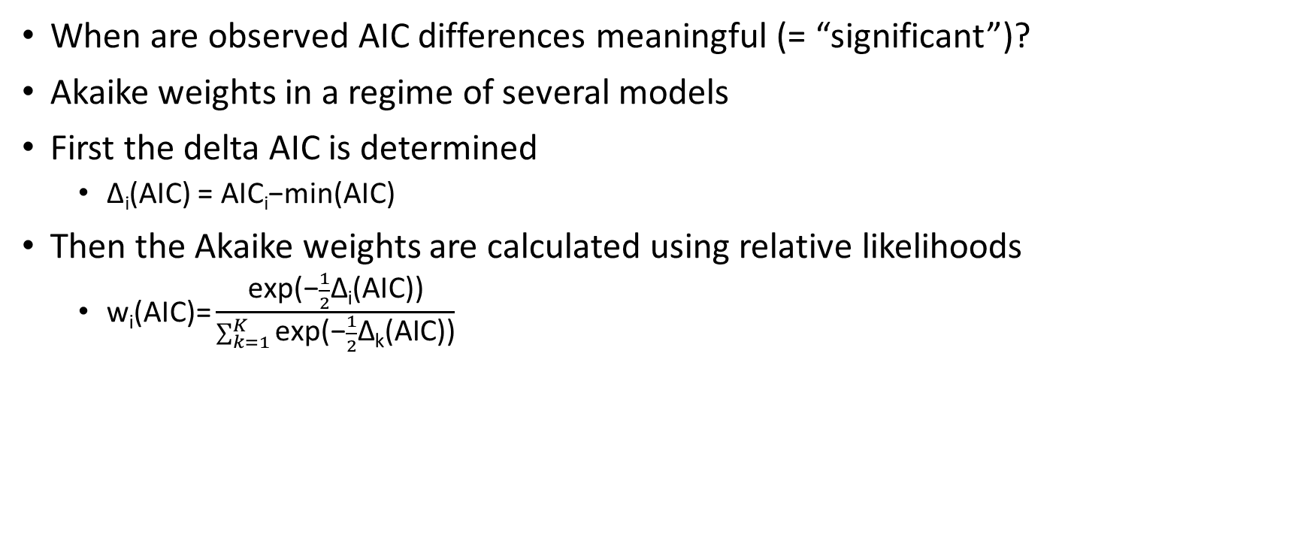
Model Selection with AIC
When are observed AIC differences meaningful (= “significant”)?
Akaike weights in a regime of several models
First the delta AIC is determined
  Δ_{i}(AIC) = AIC_{i}−min(AIC)
Then the Akaike weights are calculated using relative likelihoods
  $\text{w}\text{i}\text{(}\text{AIC}\text{)=}\frac{\text{exp}\text{(−}\frac{1}{2}\text{Δ}\text{i}\text{(}\text{AIC}\text{))}}{\sum_{k=1}^{K}{\text{exp}\text{(−}\frac{1}{2}\text{Δ}\text{k}\text{(}\text{AIC}\text{))}}}$
Burnham, K. P., and Anderson, D. R., 2002, Model selection and inference: a practical information-theoretic approach, New York, Springer,

Slide 37
Terms in vegan
Resource-partitioning models
  Null = Broken Stick = Normal
  Preemption = Geometric Series
  Lognormal = Lognormal
Statistical models (power law)
  Zipf = Zipf → Strong dominance and a long tail of rare species
  Mandelbrot = Zipf-Mandelbrot → Weaker dominance but a long tail of rare species
Notes:
Preemption = Vorwegnahme, Zuvorkommen, Vorkaufsrecht

Slide 38
Inferences in terms of ecological complexity - 1
1. Null Model (Broken stick)
  Complexity: Lowest
  Assumes species abundances are random draws from a uniform or statistical distribution with no ecological structuring (e.g., broken-stick or random fission).
2. Preemption Model (Geometric Series)
  Complexity: Low
  Assumes a strict hierarchical resource partitioning where each species takes a fixed fraction of resources, leaving less for the next. Implies competitive exclusion but lacks flexibility.
3. Zipf Model (Power Law)
  Complexity: Moderate
  Implies some form of self organization or hierarchical structuring without specifying mechanisms. Can emerge from multiplicative processes or preferential attachment.

Slide 39
Inferences in terms of ecological complexity - 2
4. Lognormal Model
  Complexity: Higher
  Assumes that species abundances result from the multiplicative effects of many independent ecological factors (e.g., niche partitioning, stochastic demographic processes). Often interpreted as the outcome of a “neutral” or “niche + stochastic” community.
5. Mandelbrot Model
  Complexity: Highest
  A generalization of the Zipf model incorporating more parameters to capture deviation in both tails of the distribution. Accounts for more subtle community structuring and niche breadth variability.
Notes:
Zipf-Mandelbrot ist closest to a log series

Slide 40
Alpha Diversity Through Time: Richness
Two phases of increase (Cambro-Ordovician, Cenozoic) in normal marine habitats
One increase in variable environments and non in high-stress environments
Bambach (1977, Paleobiology)
Notes:
Seminal study but only based on raw data. Correct to simply take statistical averages?

Slide 41
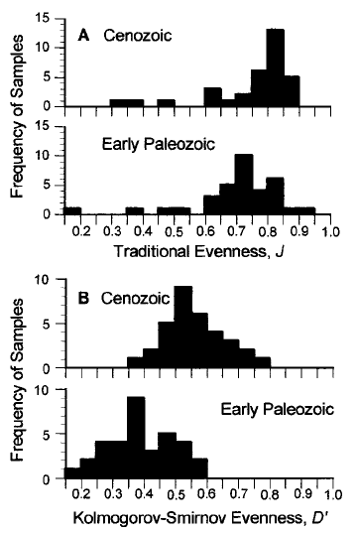
Further evenness and sampling-standardized approaches
Bush and Bambach (2004, J. Geology)
Powell & Kowalewski (2002, Geology)

Slide 42
Alpha Diversity Through Time: Rarefaction
Jurassic
Rarefaction of 400 samples
Standardized to 30 individuals
Neogene
Kowalewski et al. (2006, Paleobiology)

Slide 43
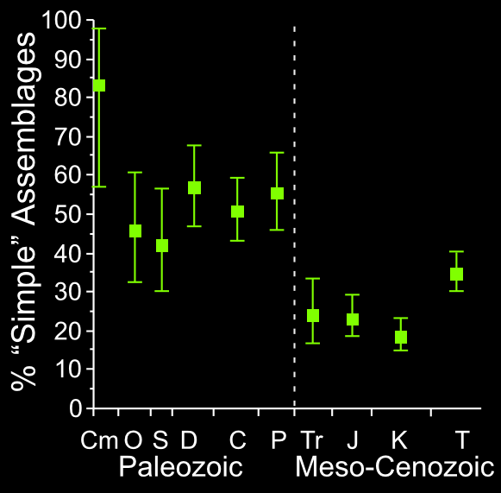
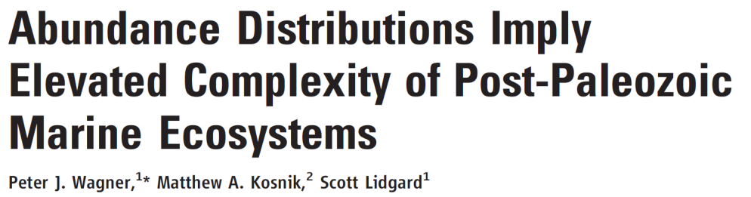
Alpha Diversity Trend Through RADs
Proportion of complex communities „suddenly“ rising after P/T boundary
Simple = Geometric series or zero-sum multinomial
Complex = Lognormal or Zipf
Wagner et al. (2006, Science)

Slide 44
H over time
Kiessling et al. (in prep)
Notes:
Lithification bias is a big thing

Slide 45

Break

Slide 46
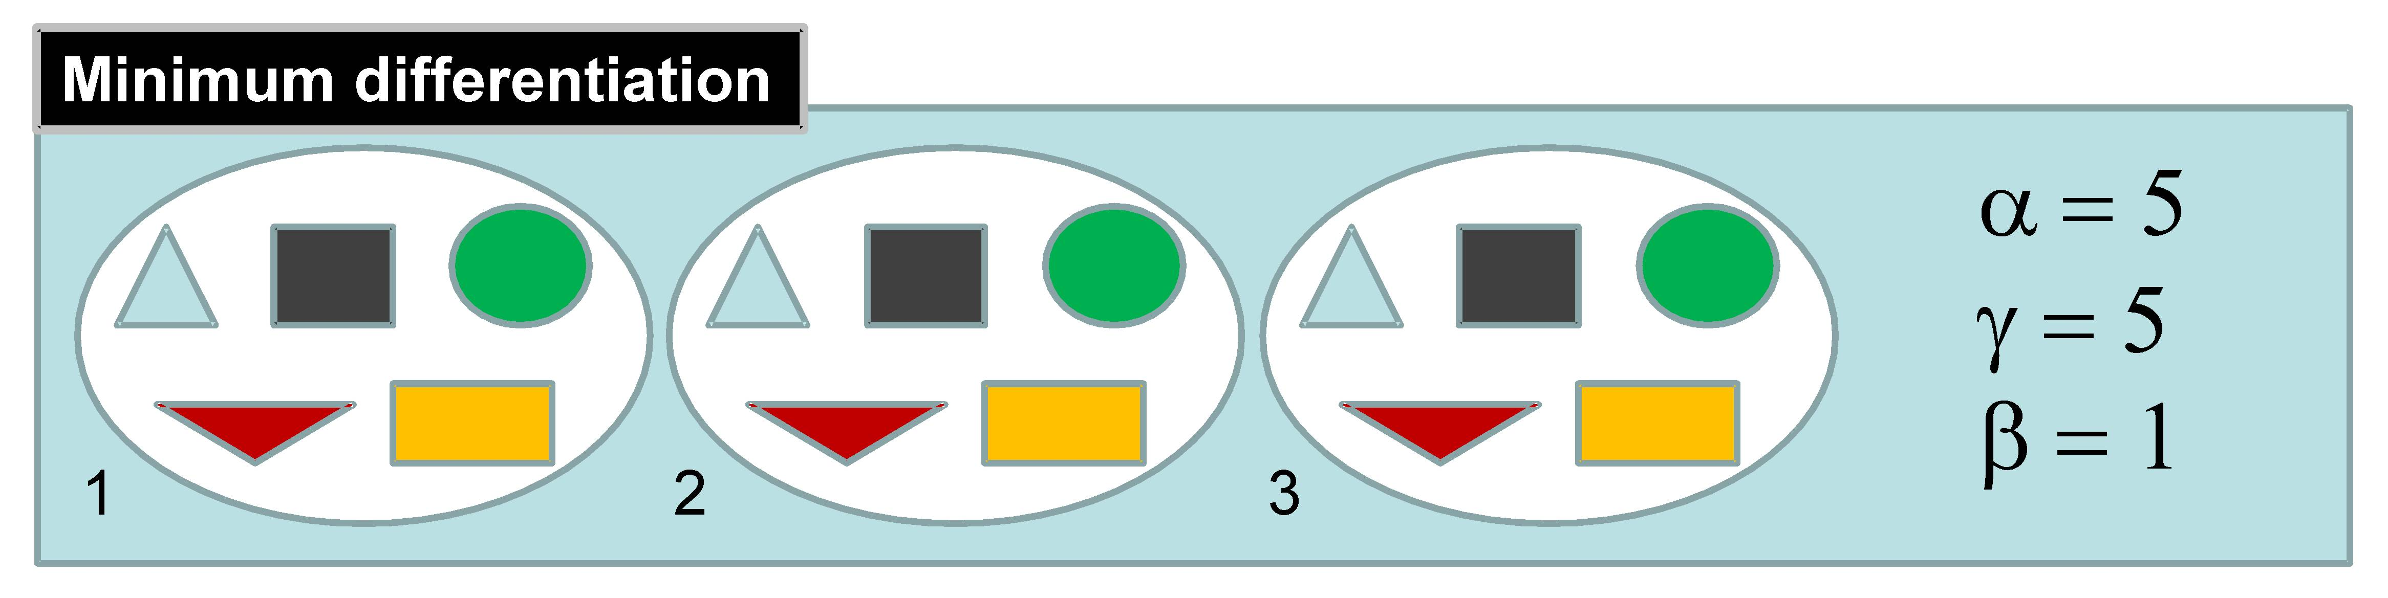
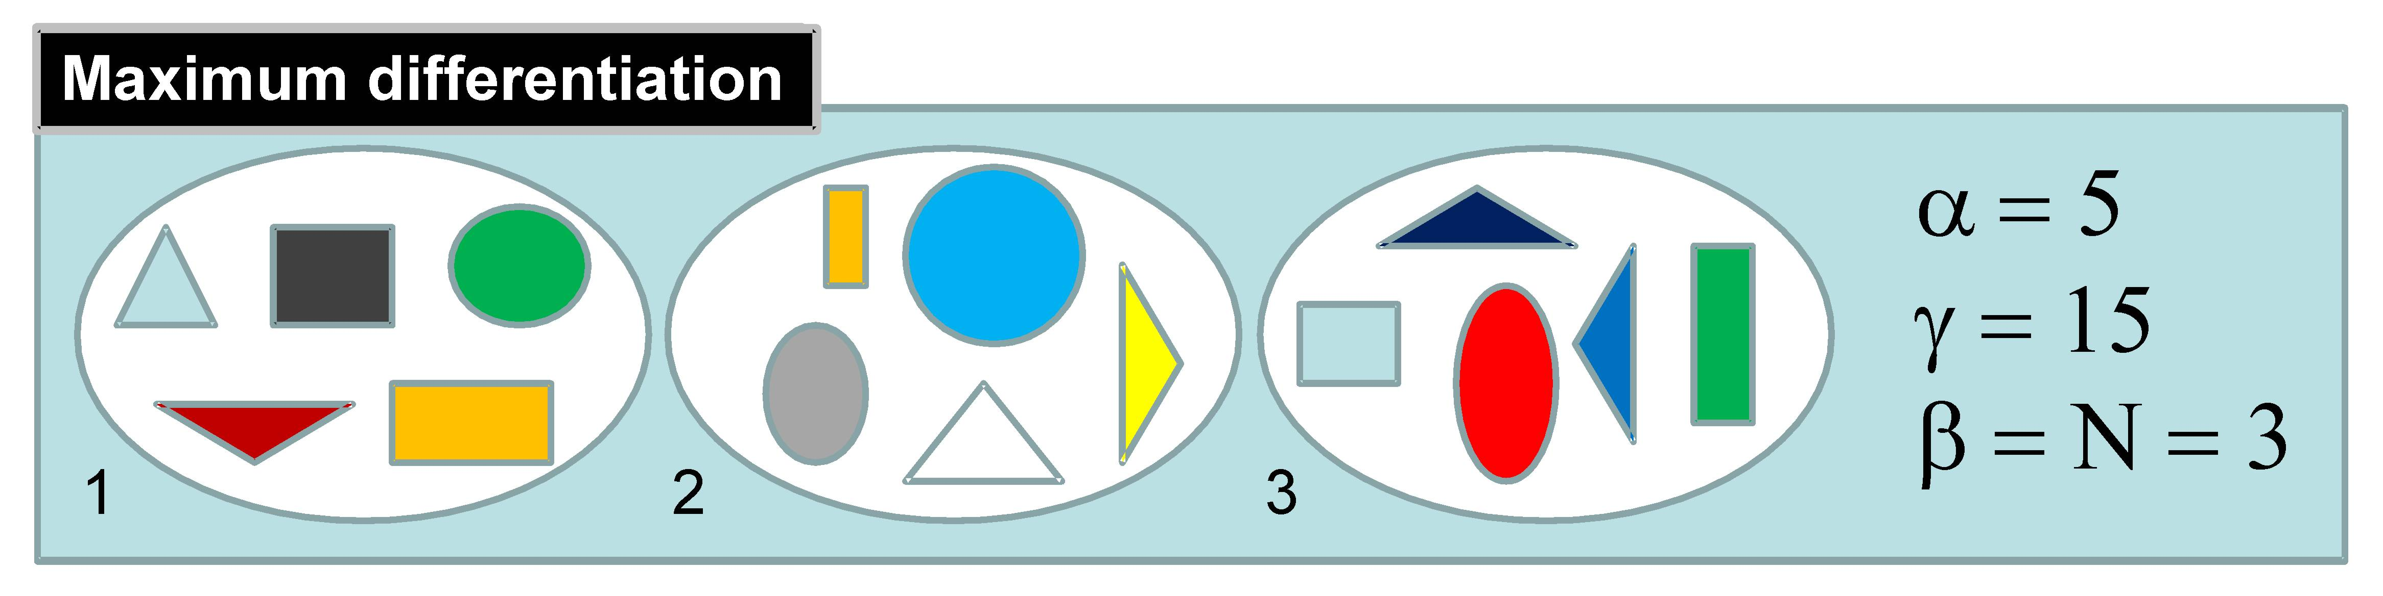
Beta diversity
https://methodsblog.com/2015/05/27/beta_diversity/

Slide 47
Beta Diversity
Assessed indirectly
  Beta = Gamma/mean(Alpha)
Assessed directly
  By dissimilarities between communities
  Use a suitable dissimilarity metric

Slide 48
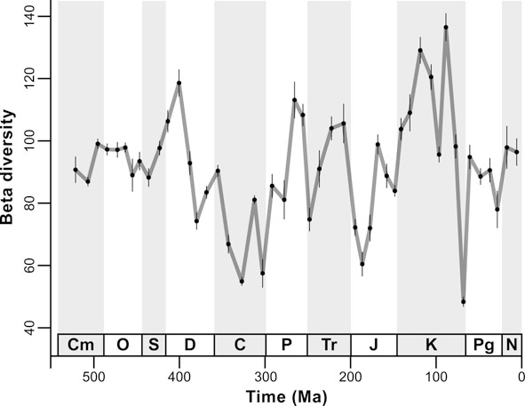
Beta Diversity Through Time
Unweigthed by-list subsampling of PBDB data
Beta = Gamma/Mean Alpha
Aberhan & Kiessling (2012)

Slide 49
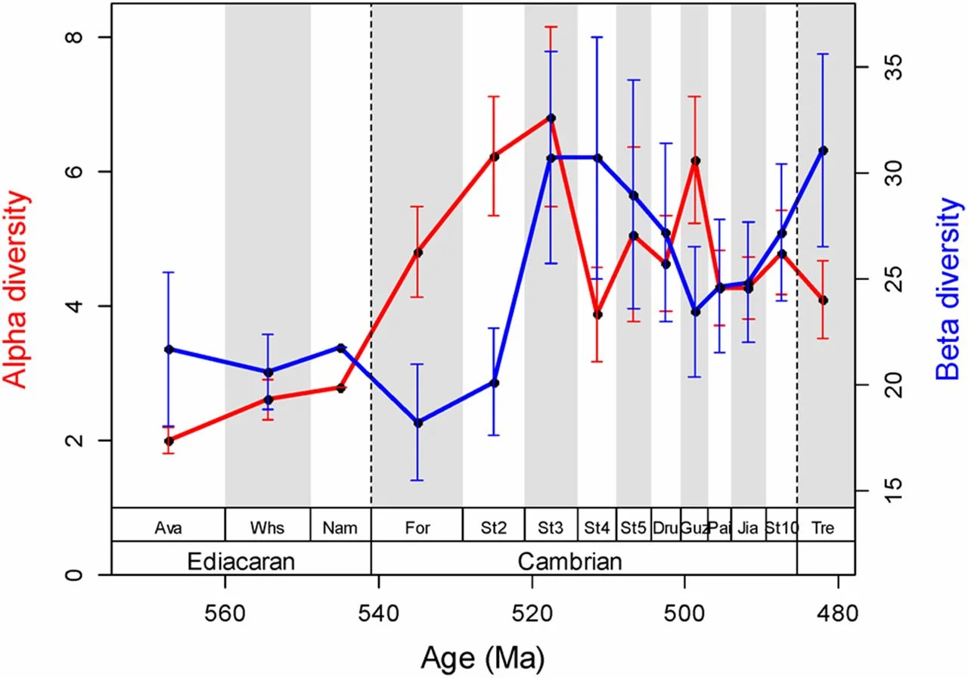
Alpha and Beta in the Cambrian Explosion
Lin and Kiessling (2015, PNAS)

Slide 50

Similarity Indices to Approach Beta Diversity
Jaccard Index:
S_{j} = a/(a+b+c)
  a = Number of shared taxa between sampling sites
  b = Number of taxa in site A not encountered in site B
  c = Number of taxa in site B not encountered in site A
Jaccard Dissimilarity = 1 - S_{j}
Good for binary data but very sensitive of different sample sizes
Equivalent to Hill number q = 0

Slide 51
Nestedness and turnover components of beta diversity
Baselga (2010)

Slide 52
Other binary metrics
Sørensen pairwise dissimilarity
  β_{Sor} = (b + c)/(2a + b + c)
  Linear relationship with Whittaker’s beta
  True turnover
Simpson pairwise dissimilarity
  β_{Sim} = min(b,c)/(a + min(b,c))
  Turnover without richness component
Nestedness (Baselga 2010)
  β_{nes} = β_{sor} - β_{sim}

Slide 53
Percent similarity
Percent similarity: P = Σ min(p_{i1}, p_{i2})
Simple and very efficient for quantitative data, same as Bray-Curtis for proportional data
I J min
A 50 80 50
B 20 0 0
C 30 20 20
70%
Notes:
Corresponds to Hill numbers between 1-2

Slide 54
Hill numbers and beta diversity
For q=0 (species richness), the appropriate dissimilarity is based on the Jaccard or Sørensen index (incidence-based).
For q=1 (Shannon diversity), the best analogue is the Jaccard turnover measure based on Shannon entropy, sometimes referred to as the Shannon–Jaccard dissimilarity. This uses the effective number of species derived from Shannon entropy.
For q=2(Simpson diversity), the corresponding measure is a Sørensen–Horn dissimilarity (Horn 1966; also called Morisita–Horn index).
Chao et al. (2014, Ecol. Monographs)

Slide 55
Exercise
Calculate beta diversity of radiolarian faunas?
Start with two samples and then go to entire matrix
Script: Beta_div.R
Notes:
In Zukunft Studenten selbst

Slide 56
What to do with a (dis)similarity matrix
Structure detection
  Explore groups versus gradients over space and time
Approaches
  Cluster analysis
  Non-metric multidimensional scaling

Slide 57
Hierarchical Cluster Analysis
Hierarchical (nested) grouping of data
  Between variables (Q-Mode)
  Between cases (R-Mode)
Paleobiological
  Q-Mode: Groups of samples
  R-Mode: Groups of species or higher taxa
Divisive or agglomerative
Fully reproducible
Works with any similarity or distance metric

Slide 58
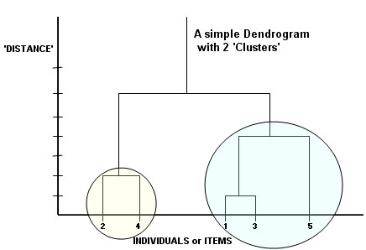
Steps in Cluster Analysis
Similarity/Dissimilarity (or distance) matrix
Agglomeration: Link pairs of objects to form small clusters
Treat small clusters as new objects and repeat procedure until all objects are related

Slide 59
Agglomeration Methods (Selection)
Nearest Neighbor or Single Linkage Clustering: Similarity between two clusters equals the maximum similarity between any two members of the clusters
  Tends to produce chaining (friends of friends)
Farthest Neighbor or Complete Linkage Clustering: Similarity between two clusters equals the minimum similarity between any two members of the clusters
  Tends to produce clear groups, even if similarity between members is great
  Default method in R function hclust()
Unweighted Group Average or Unweighted Pair Group Method with Arithmetic Averaging: Similarity between two clusters equals the mean similarity between all possible pair-group combinations
  Intermediate between single and complete. Most commonly used in paleoecology
Centroid Clustering or Unweighted Pair Group Method with Centroid Averaging: Similarity between two clusters equals their similarities as composite objects
Ward’s Method: Objects are grouped that minimize the variance of the similarities between all member objects within a cluster
  Recommended method
  ward.D2 in R

Slide 60
Exercise
Find the biogeographic structure in Late Jurassic-earliest Cretaceous radiolarian samples collected from
  Antarctica (K, GD, LG)
  The Alps (AM, Bu, PS, Sc, Sg, Stg)
  Oman (JB, JH, Na)
  Philippines (R)
Biogeographic vs. stratigraphic signal?
  Alps: Callovian to early Tithonian
  Oman: Berriasian-Valanginian
  Antarctica: Kimmeridgian-Berriasian

Slide 61
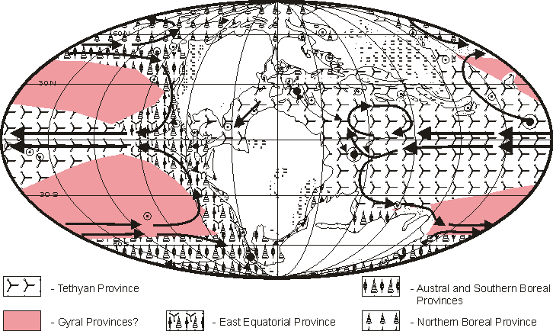
Reconstructed Radiolarian Provinces in the Tithonian
Kiessling (1999, Micropaleontology)

Slide 63
Ordination
Complementary to clustering but
  Allows better representation of larger distances
  Objects arranged on continuous axes
  No forced hierarchical structure
  Shapes of clusters can be seen (if real)
  Gradients can be seen (if real)
Explorative rather than for hypothesis testing
  Principal Component and Factor Analysis
  (Detrended) Correspondence Analysis
  Multidimensional Scaling

Slide 64
Principal Component Analysis (PCA)
Orthogonal transformation of several potentially correlated variables into a (reduced) set of uncorrelated variables, the principal components (PCs)
Number of PCs is ideally much less than original set of variables
PCs extracted in successive form such that each explains the maximum (remaining) variance of the whole dataset
Factor analysis is a specific case of PCA
PCA most commonly applied in morphometrics

Slide 65
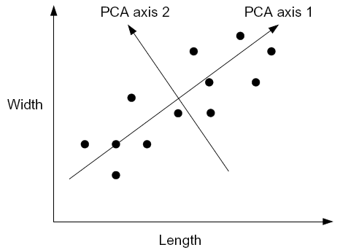
Example
Length and width of shark teeth in a species
Values well correlated but high variance
Rotate coordinate system to achieve the minimum variance
Interpretation of new axes (PCs):
Axis 1: Size, Axis 2: Width-Length ratio

Slide 66
Multidimensional Scaling (MDS)
An ordination technique in which the scatter of points representing samples or taxa in an ordination space is iteratively allowed to evolve until it resembles the observed dissimilarity matrix as closely as possible
Two methods
  Metric (MDS): Actual values of dissimilarity are considered (aka Principal Coordinate Analysis)
  Non-metric (NMDS): The ranking of dissimilarity is analyzed
Basic steps
  Dissimilarity or distance matrix of objects
  Specify dimensionality (usually 2D or 3D)
  Project or squeeze distances on the ordination space and identify the stress this imposes
  Minimize the stress by moving points in ordination space
Note: Axes are arbitrary and can be rotated as wished

Slide 67
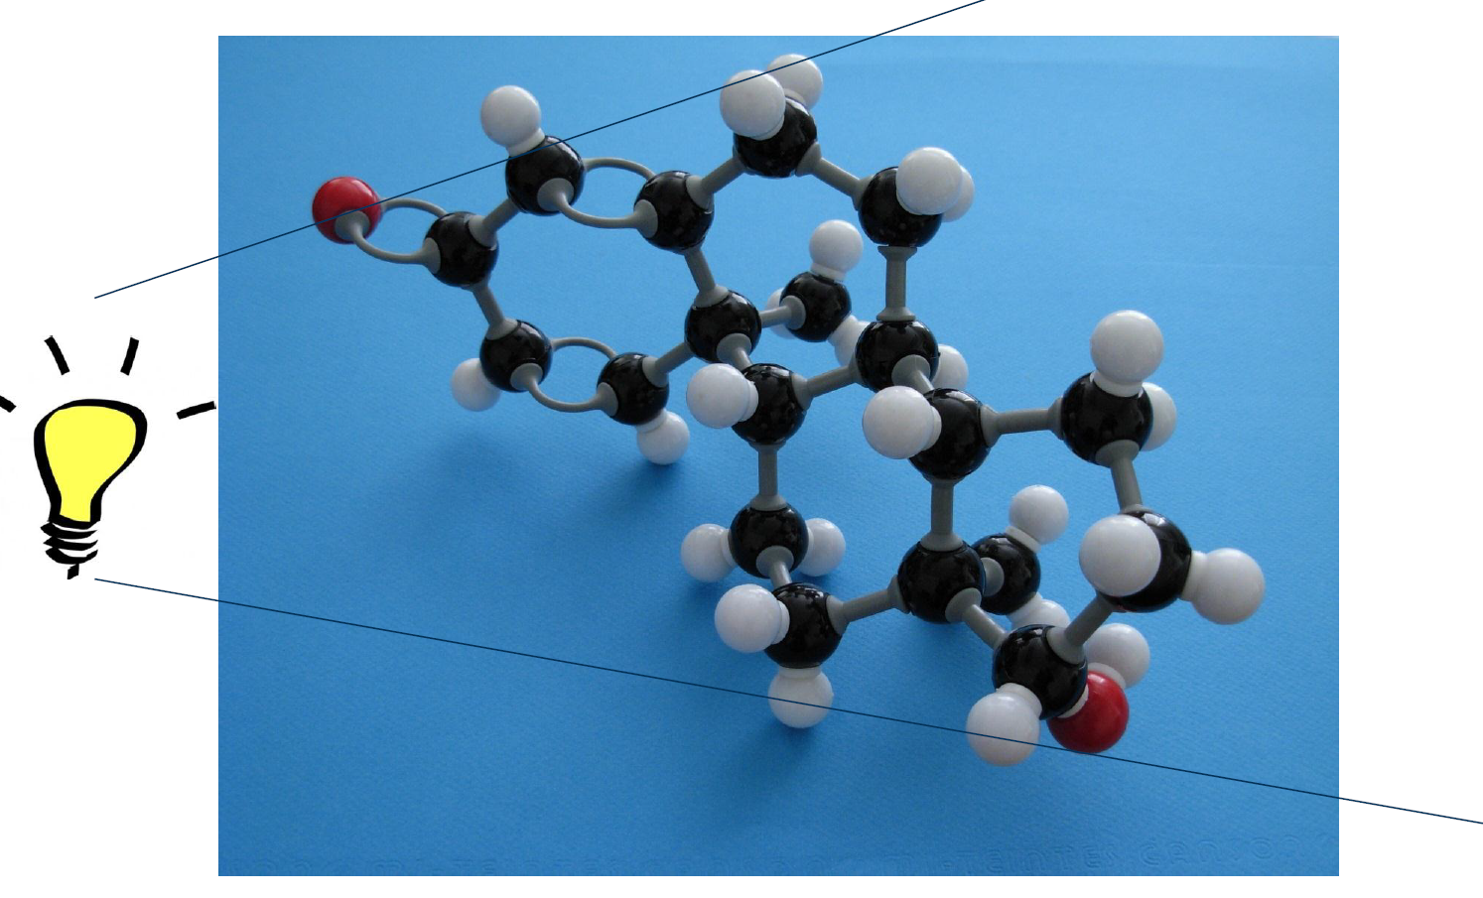
MDS (Metric = Parametric)
Projection on a plane

Slide 68
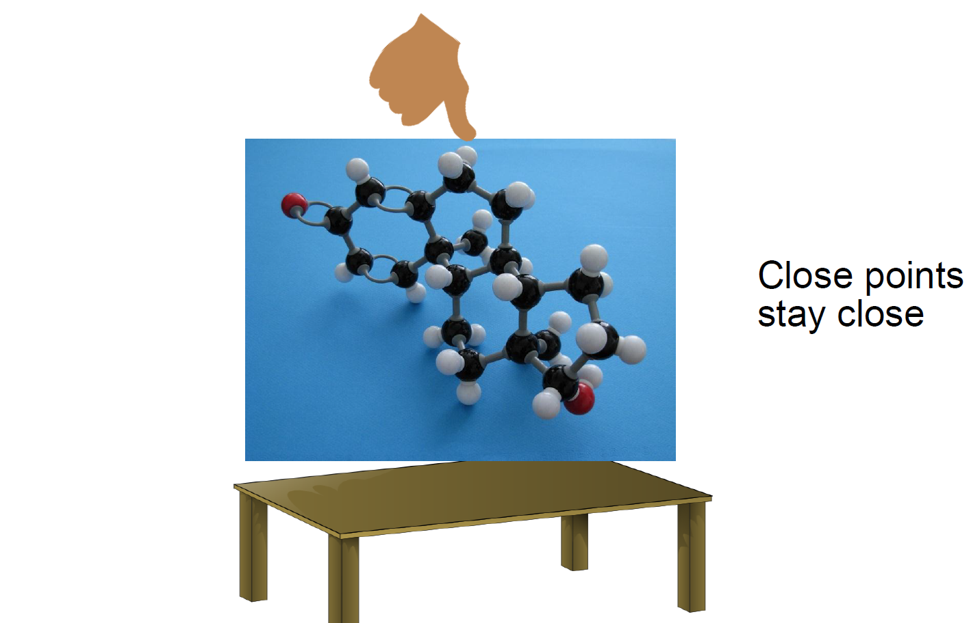
NMDS (Non-metric = non-parametric)
Squeezing on a plane

Slide 69
A simple example of MDS (Principal Coordinate Analysis)
Given: Distances of European Cities
Task: Calculate a map of Europe with just these data
  eurodist
  loc <- cmdscale(eurodist, k =2)
  plot(loc, type="n")
  text(loc, rownames(loc), cex = 0.6)
Relative positions are correct but true coordinates are wrong
Change this by transforming one variable
  x <- loc[, 1]
  y <- -loc[, 2]
  plot(x, y, type = "n", xlab = "", ylab = "", asp = 1, axes = FALSE, main = "cmdscale(eurodist)")
  text(x, y, rownames(loc), cex = 0.6)

Slide 71
Try With Radiolarian Data
As in metric approaches, the first axis explains most of the variance, but there is no strict “% variance explained”
Compare with metric

Slide 72
Stress: How much pressure is needed to squeeze multidimensional object on two (or three) dimensions?
With metaMDS: Stress values >0.2 are generally poor and potentially uninterpretable; values <0.1 are good and <0.05 are excellent, leaving little danger of misinterpretation.
Stress values between 0.1 and 0.2 are useable but some of the distances will be misleading.
mMDS$stress
# Evaluate scatter around the regression between the interpoint distances in the final configuration
stressplot(mMDS) # how well does the two-dimensional distance correspond to the true distance?

Slide 73
Sites and species together
plot(mMDS)

Slide 74
Metric MDS and grouping
Oman
Antarctica
Alps, Philippines

Slide 75
Main Assignment
Paleoecological data are provided for the middle Triassic of South China
Compute patterns of alpha and beta diversity across all samples
Are there distinct groups of samples?
Is group membership predicted by diversity or other ecological properties?
How good is the Berger-Parker-Index to predict more complex measures of diversity such as Shannon’s H?

Slide 76
Get started
Calculate beta diversity of Triassic faunas
Use matrix
Script: Beta_div_Bangtoupo.R
Notes:
In Zukunft Studenten selbst

