Slide 1

Advanced Shape Analysis
Ryan N. Felice

Slide 2
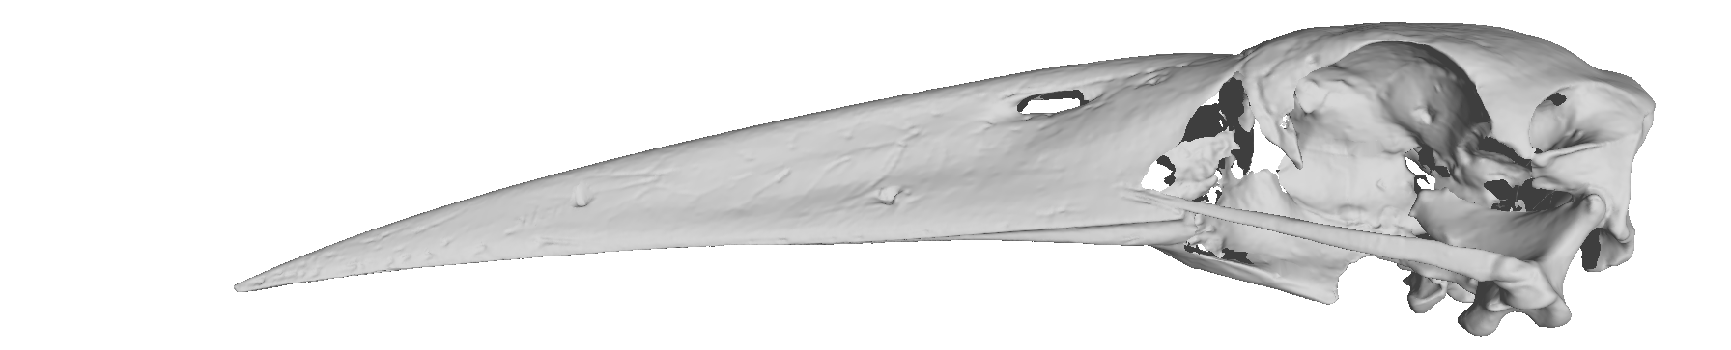
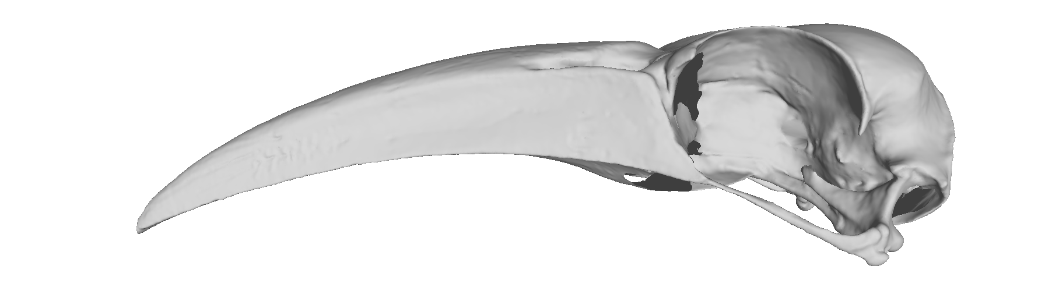
Sliding Semilandmarks

Slide 3
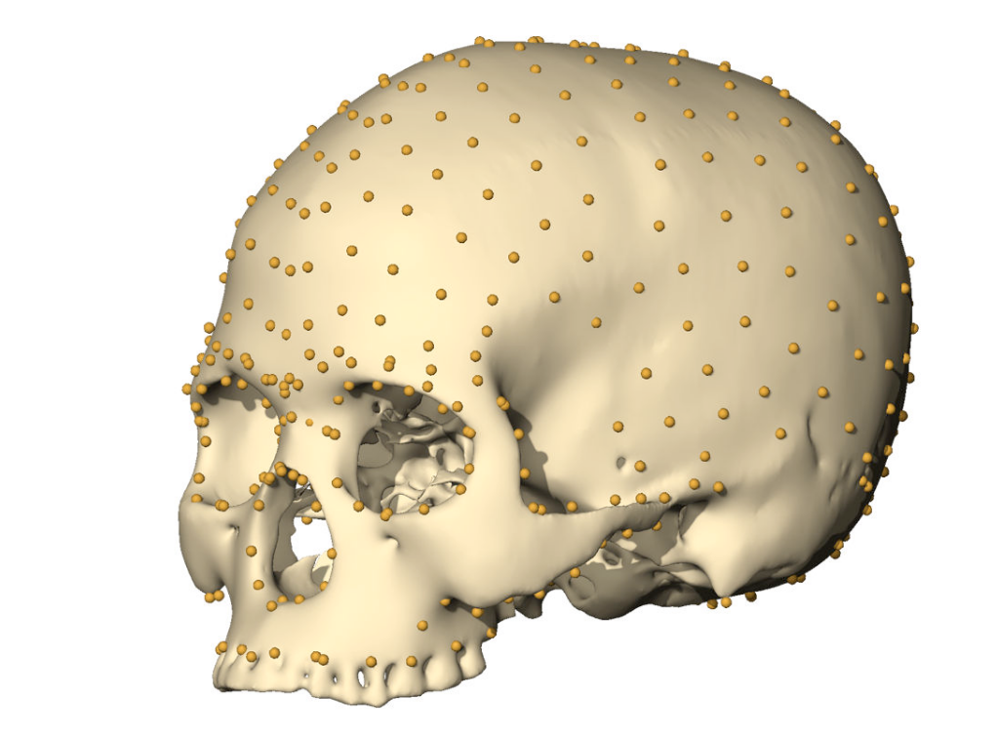
Surface Semi-landmarks
Gunz and Mitteroecker 2013

Slide 4
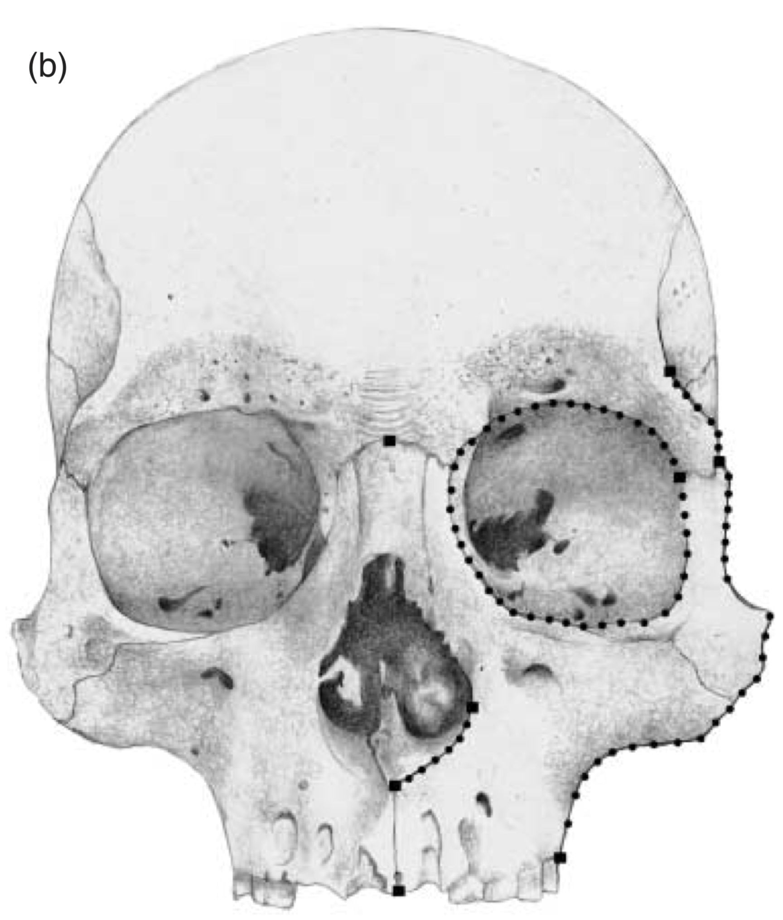
Sliding Semilandmarks
Perez et al 2006

Slide 5
Sliding Semilandmarks
1
2
Perez et al 2006

Slide 6
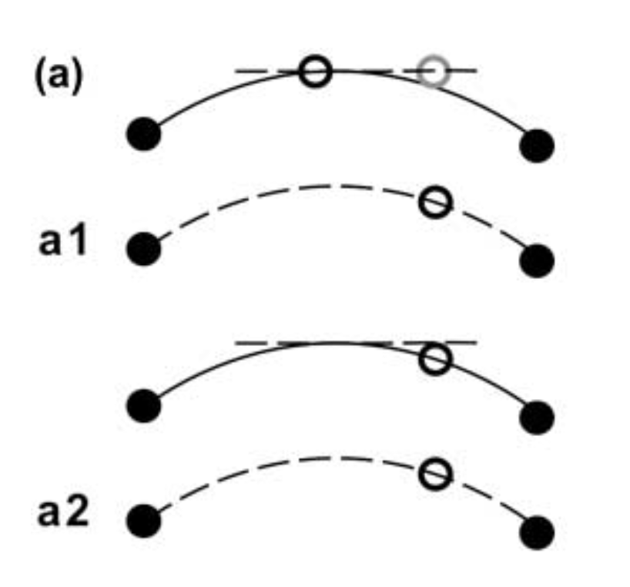
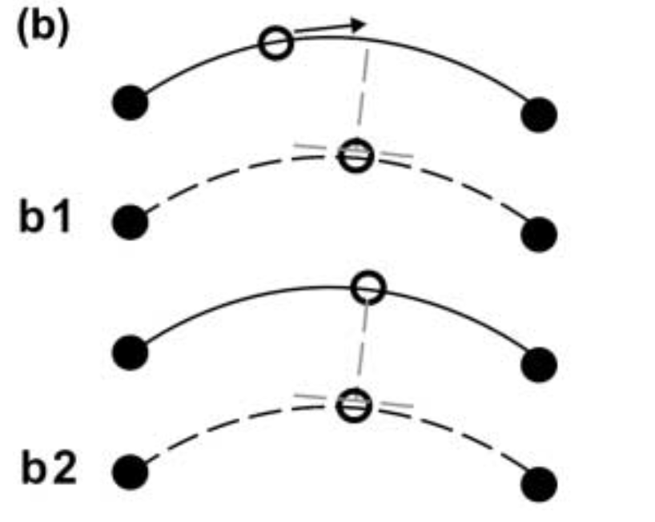
Sliding Semilandmarks
Bending Energy
Procrustes Distance
Perez et al 2006

Slide 7
Sliding Semilandmarks
Bending Energy
Procrustes Distance
Perez et al 2006

Slide 8
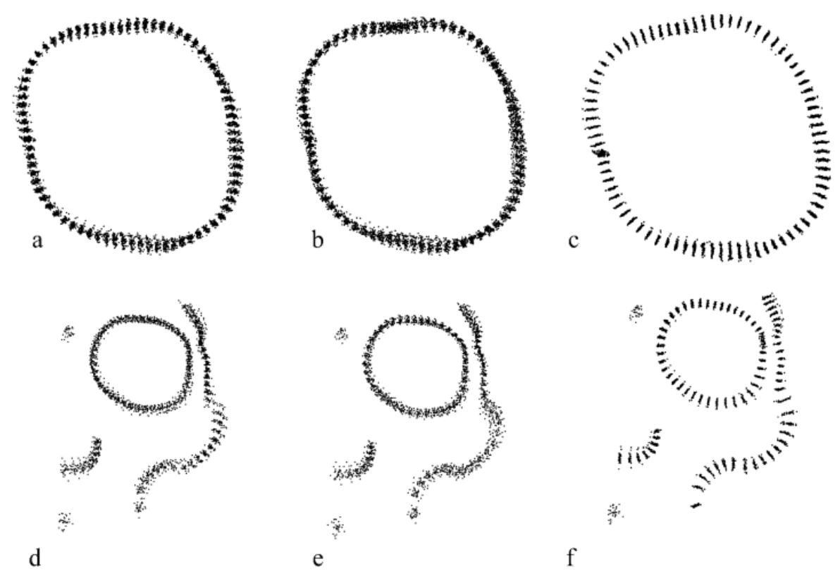
Sliding Semilandmarks
Analytical Paleobiology Workshop - Erlangen 2023

Slide 9
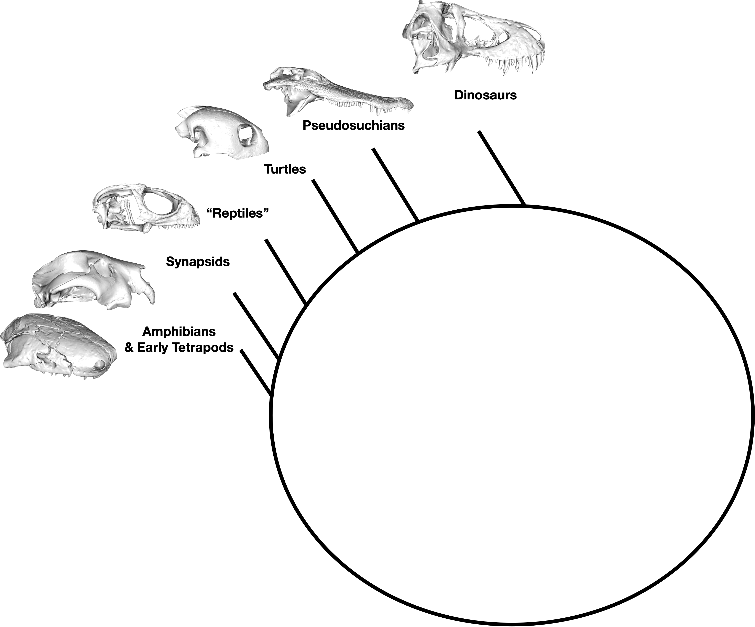
The Problem

Slide 12
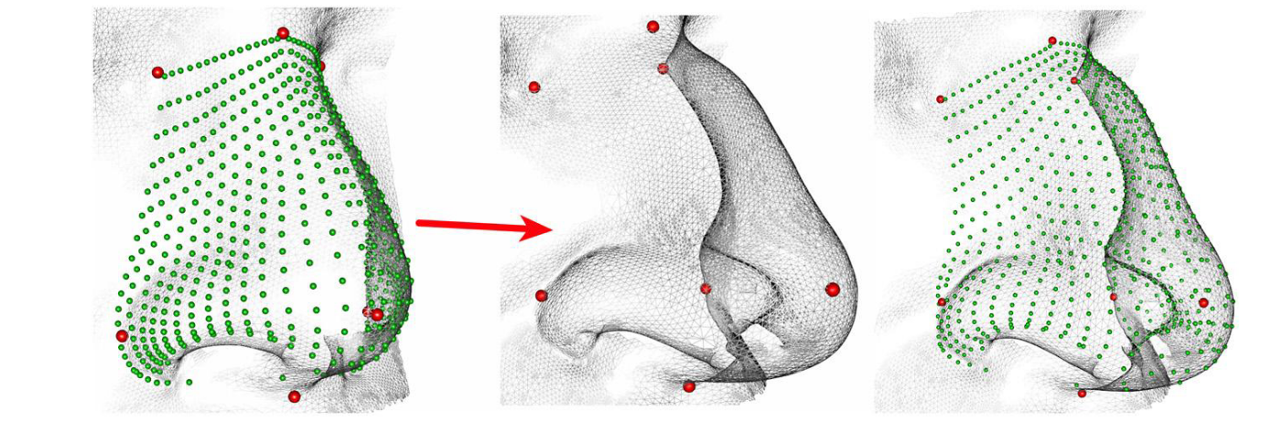
Semi-automated patching
Morpho R package
Schlager 2017

Slide 13
Bardua et al 2019

Slide 14
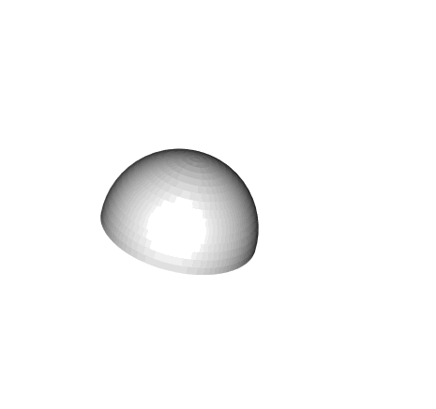
Warp
Bardua et al 2019

Slide 15
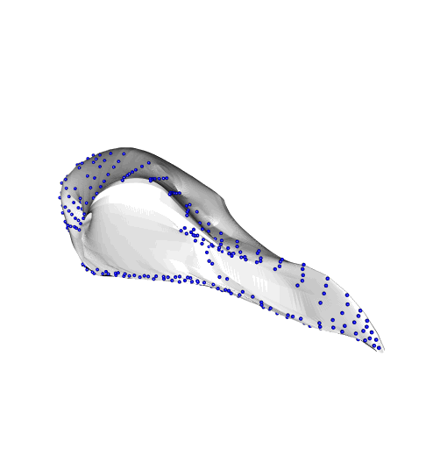
Inflate
Bardua et al 2019

Slide 16
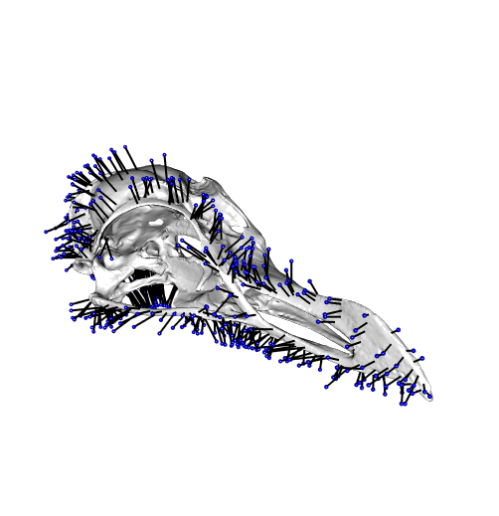
Project
Bardua et al 2019

Slide 17
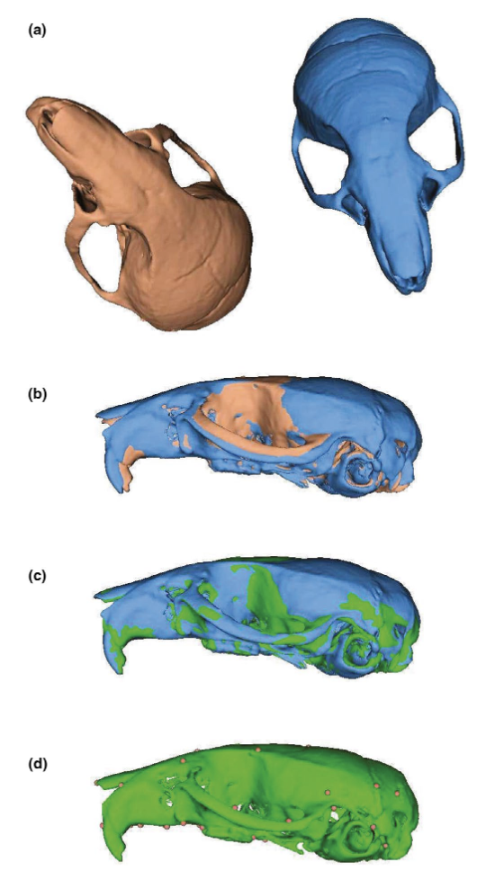


Slide 18
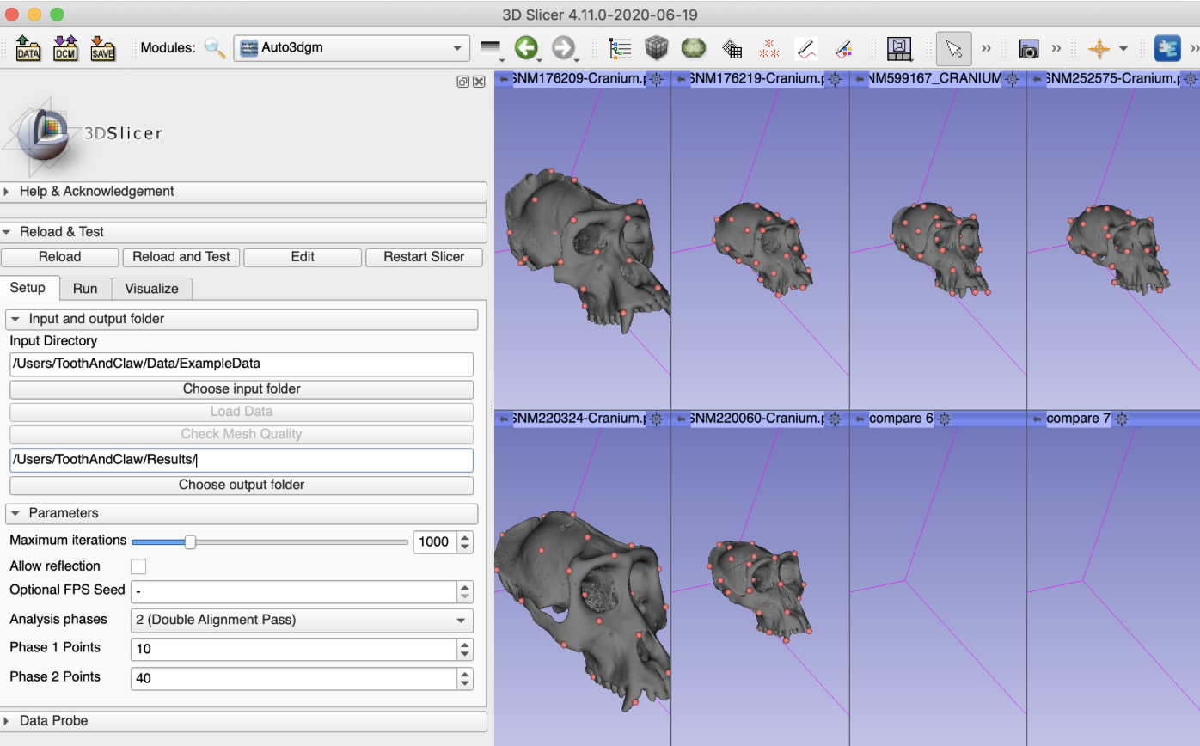
Pseudolandmarks- Auto3dGm
https://toothandclaw.github.io

Slide 19
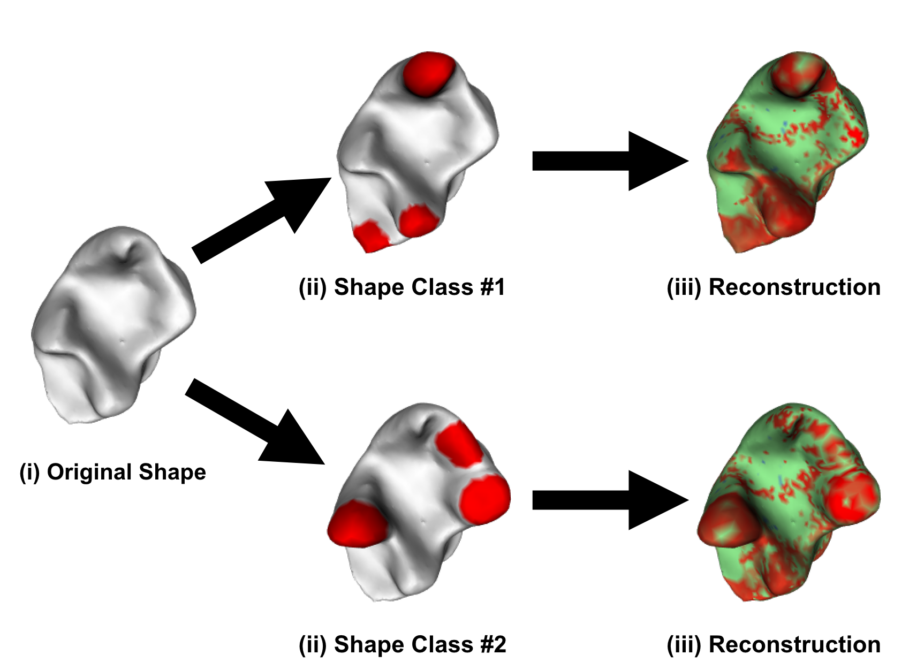

Slide 20
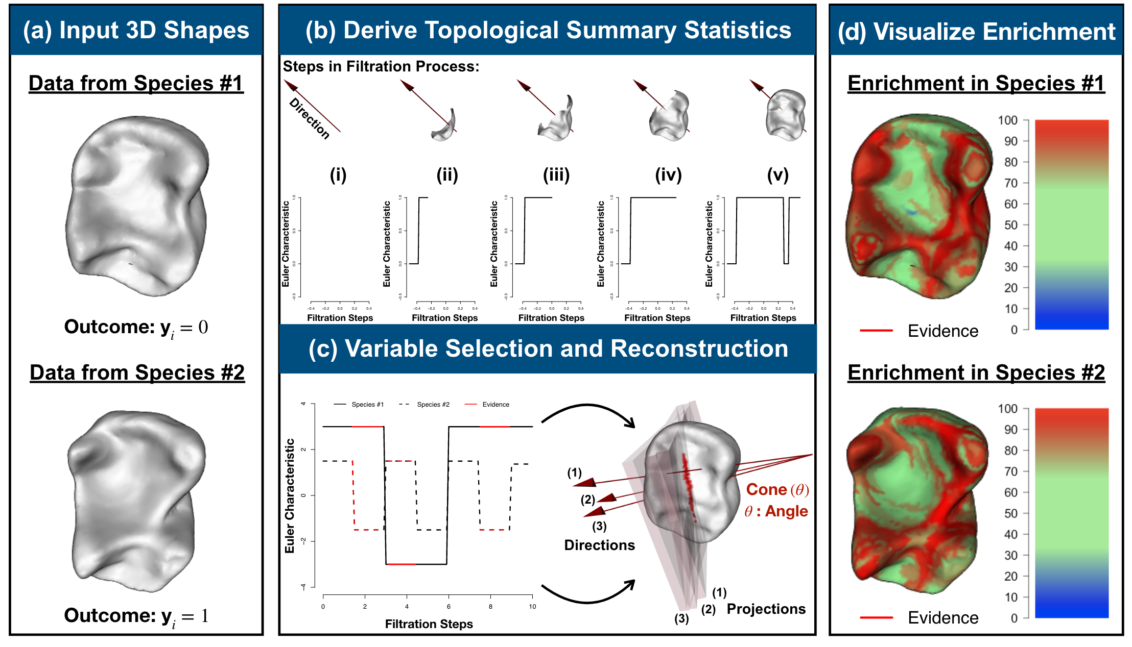

Slide 21
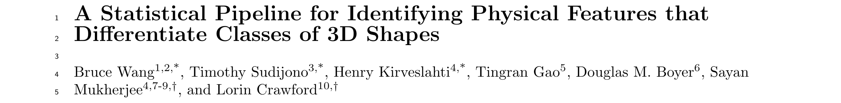

Slide 22
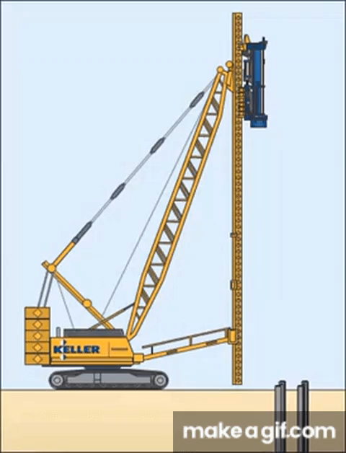

How much firepower do I need?
VS.

Slide 23
Modelling High Dimensional Data
 | Trait 1 | Trait 2 | Trait 3
Species 1
Species 2
Species 3
Species 4
Species 5
Species 6
Species 7
What do we mean by high dimensional data?
N = number of observations
P = number of variables
 | Trait 1 | Trait 2 | Trait 3 | Trait 4 | Trait 5 | Trait 6
Species 1
Species 2
Species 3
Species 4

Slide 24
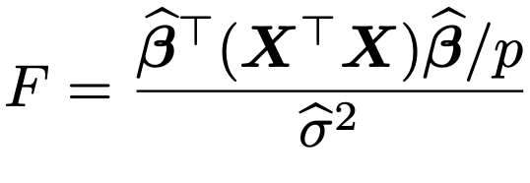
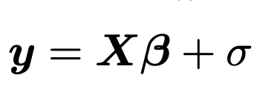
Modelling High Dimensional Data
Who cares?
Everything is linear models
Estimating F-statistic and likelihood of linear models with p>N is impossible (you can’t invert a matrix that has p>N)
“Curse of dimensionality”

Slide 25
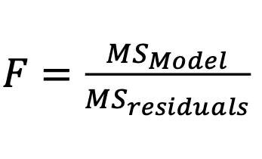
The Solution:
RRPP: Residual randomization in permutation procedure
F-statistic (and significance) is computed by randomizing the residuals of the model and comparing to a null
MS = Mean squares

Slide 26
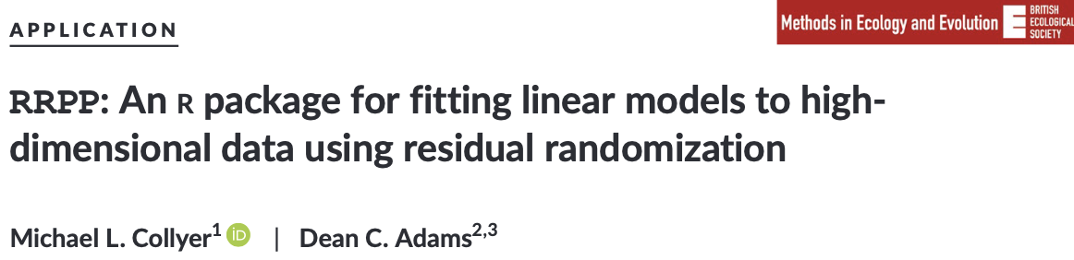
The Solution:
RRPP: Residual randomization in permutation procedure
F-statistic (and significance) is computed by randomizing the residuals of the model and comparing to a null
Recommendations:
Always think about what methods are appropriate for your data
Use procD.lm or procD.pgls functions in geomorph or lm.rrpp in the RRPP package
https://doi.org/10.1111/2041-210X.13029

